Slide 1
Higgs Properties Measurement using H→ZZ*→4l Decay Channel
Haijun Yang and Liang Li
The 23rd ATLAS Chinese Cluster Meeting
IHEP, Beijing, 2013. 3. 3

Slide 2
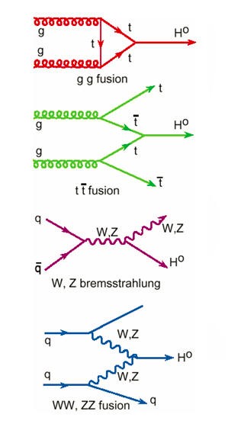
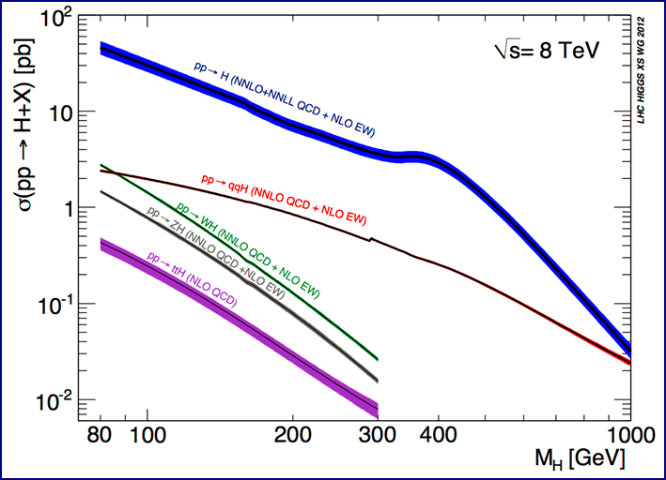
Higgs Boson Production at LHC
Gluon-gluon fusion gg→H and vector-boson
fusion qq→qqH are dominant
Yukawa
coupling
Gauge
coupling
Inelastic pp cross section at 7 TeV is ~ 60 mb

Slide 3
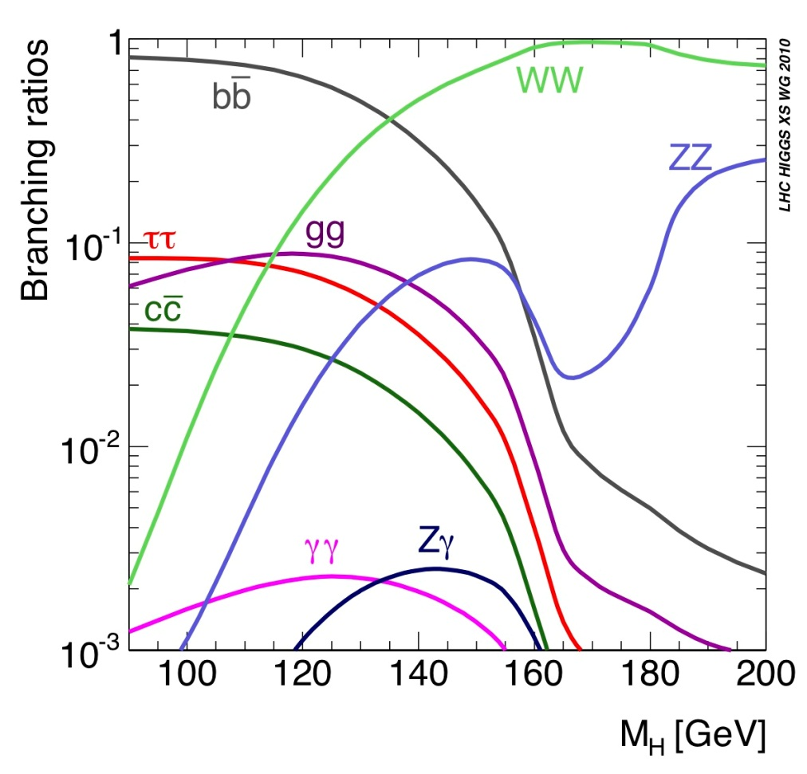
Higgs Boson Decay
Higgs decay branching
ratio at m_{H}=125 GeV
bb: 57.7% (huge QCD background)
WW: 21.5% (easy identification in di-lepton mode, complex background)
ττ: 6.3% (complex final states with τ leptonic and/or hadronic decays)
ZZ*: 2.6% (“gold-plated”, clean signature of 4-lepton, high S/B, excellent mass peak)
γγ: 0.23% (excellent mass resolution, high sensitivity)
Higgs boson production rate:
1 out of 10¹² collision events

Slide 4
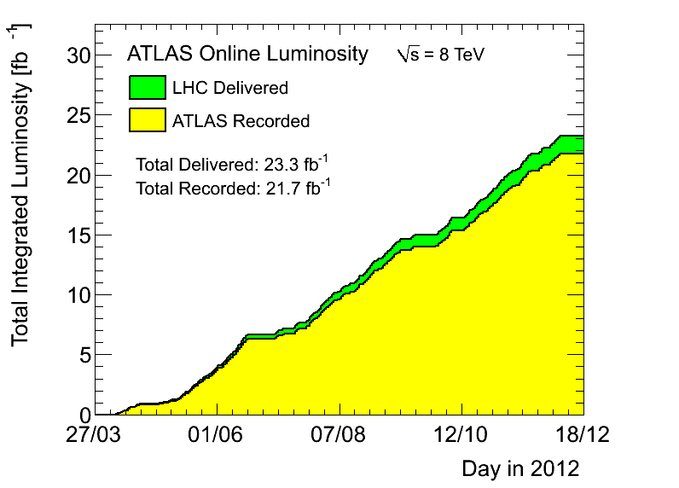
ATLAS Data Samples
7 TeV data samples (2011)
4.8 fb⁻¹ for physics analysis
Peak luminosity 3.6×10³³cm⁻²s⁻¹
8 TeV data samples (2012)
20.7 fb⁻¹ for physics analysis
Peak luminosity 7.7×10³³cm⁻²s⁻¹
Data-taking efficiency: ~94%
Significant pileup events
Moriond2013
HCP2012
ICHEP2012

Slide 5
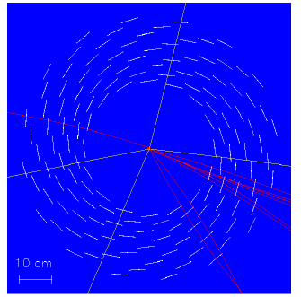
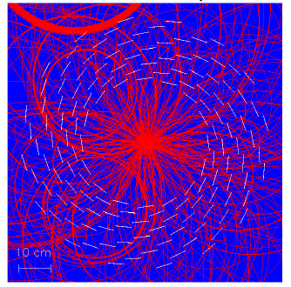
Major Challenge
Large pileup events result in big challenge to the detector, reconstruction and particle identification !
H→ZZ→4μ
μ
μ
μ
μ

Slide 6
Higgs → ZZ* → 4l

Slide 7
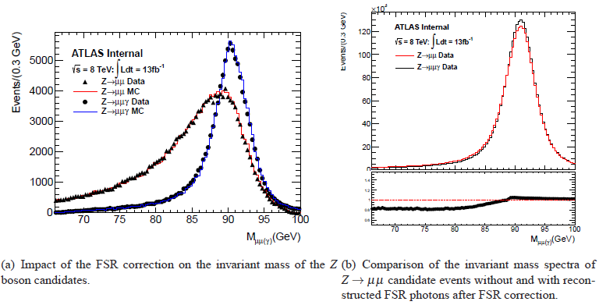
Impact of the FSR Correction
Photon energy > 1 GeV

Slide 8
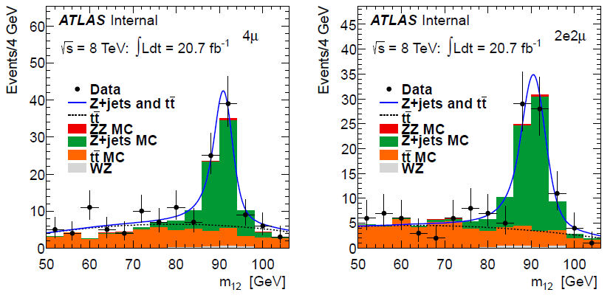
Estimation of ttbar, Zbb background
The control region: four-lepton analysis selection except for isolation requirements on the sub-leading pair and at least one sub-leading leptons is required to fail the IP significance requirement, to suppress ZZ.

Slide 9
Estimation of ttbar, Zbb background
Ttbar and Zbb background estimation using a fit on m₁₂ distribution (2nd order Chebychev polynomial for ttbar, Briet-Wigner line shape with Crystal-Ball resolution function for Zbb)

Slide 10
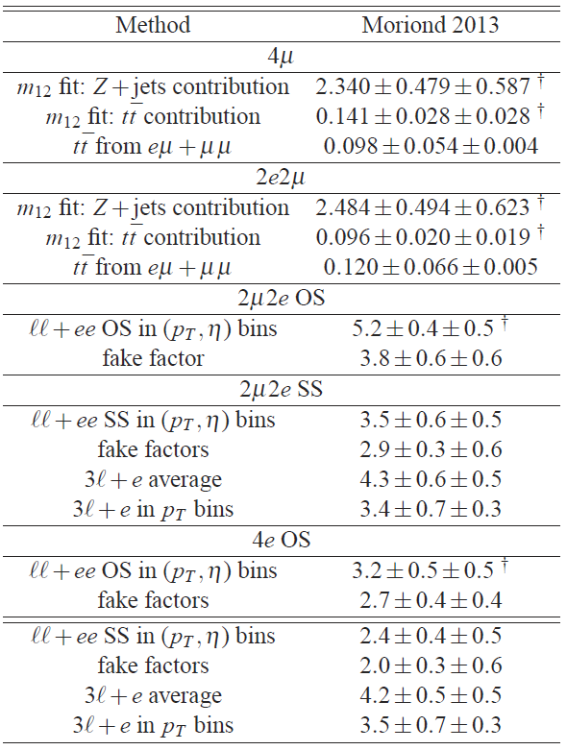
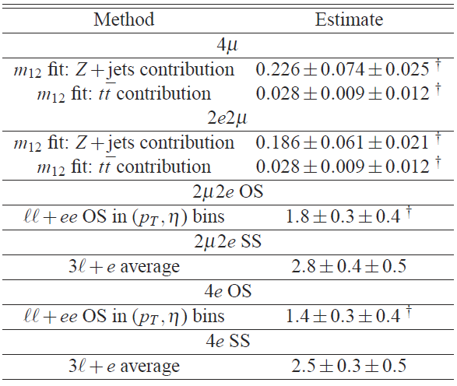
Summary of Inclusive Backgrounds
7 TeV, 4.6fb⁻¹
8 TeV, 20.7fb⁻¹

Slide 11
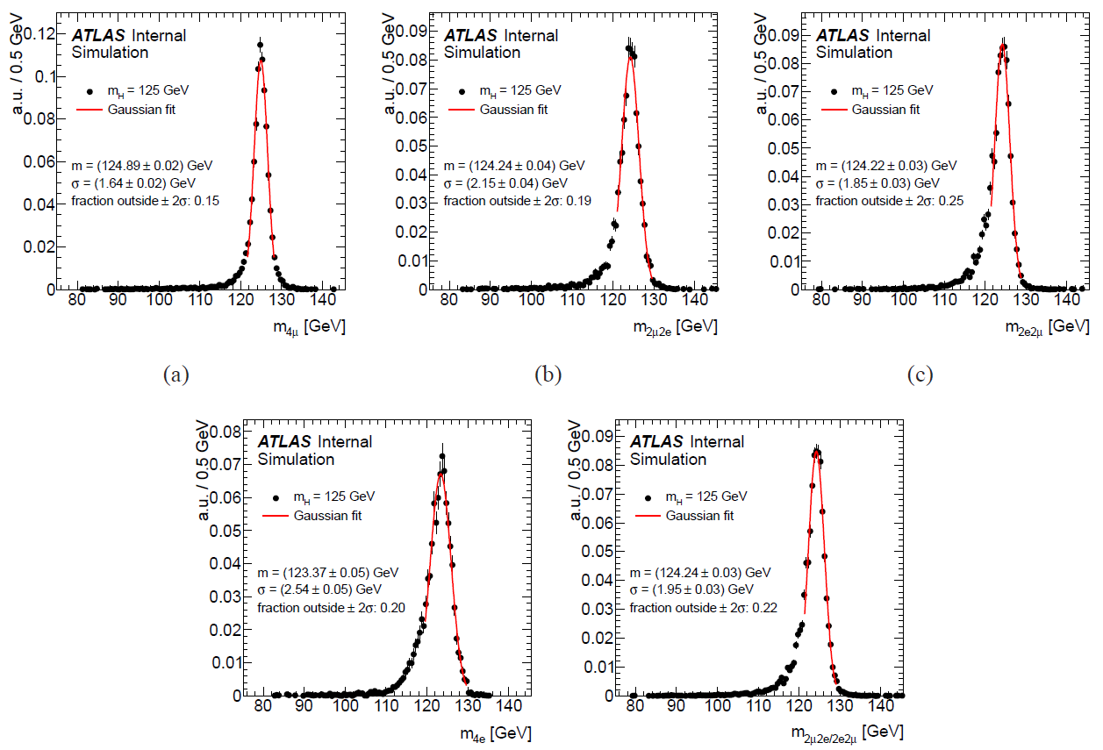
Higgs Mass Resolution
➔ Gaussian fit:
FSR correction &
Z mass constraint

Slide 12
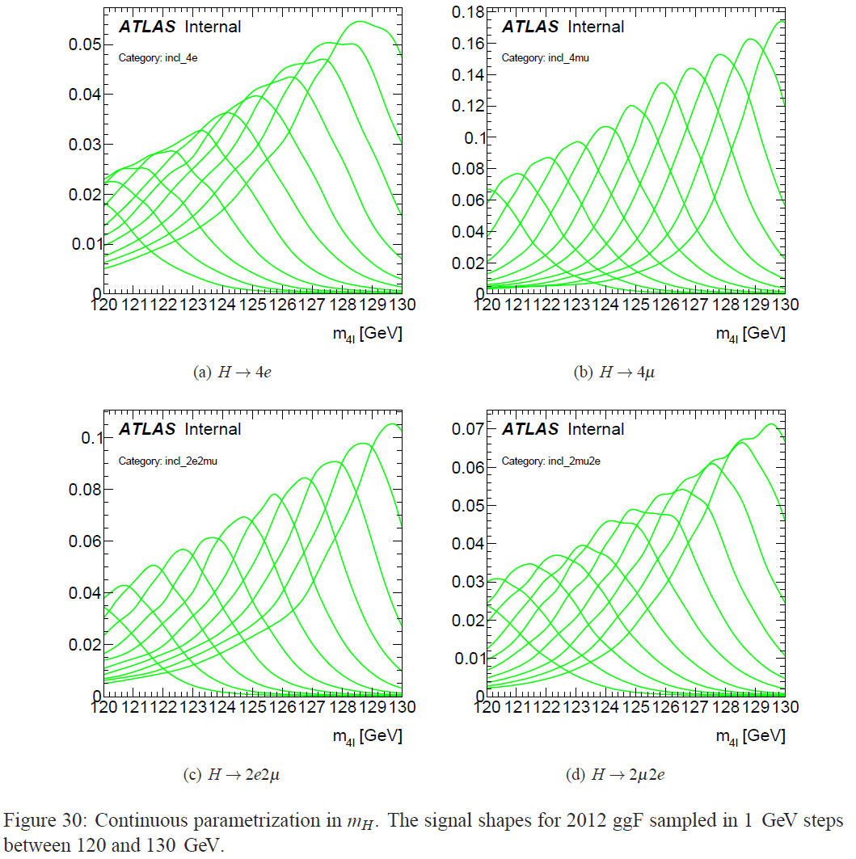
Simulated Higgs Signal Shapes

Slide 13
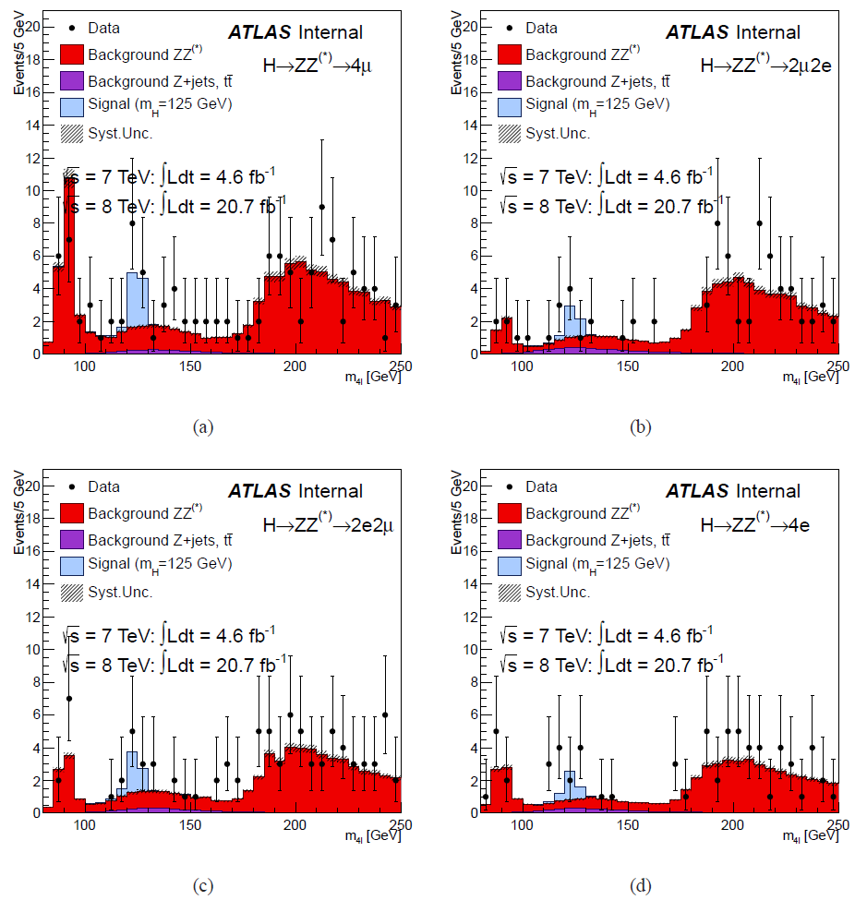
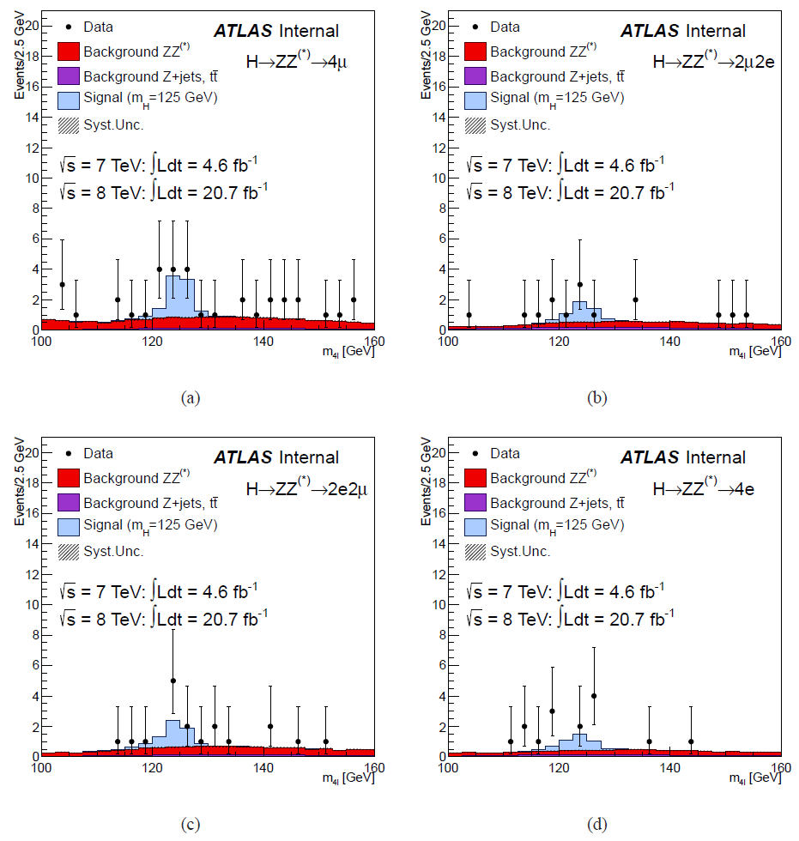
M_{4l} of Four Different Final States (4μ, 2μ2e, 2e2μ, 4e)

Slide 14
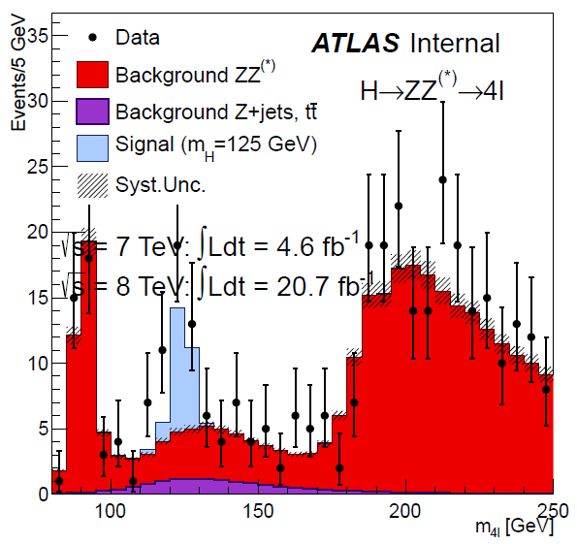
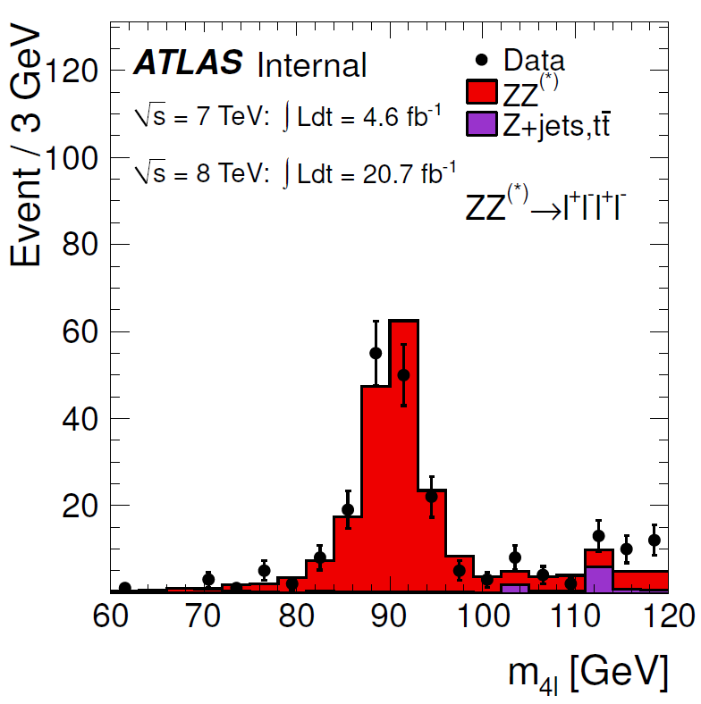
H→ZZ*→4l mass spectrum
Single resonant Z→4l enhanced by relaxing mass and P_{T} requirements (21 + 141 = 162)

Slide 15
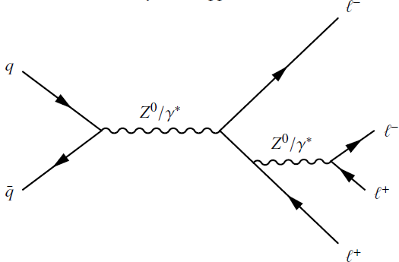
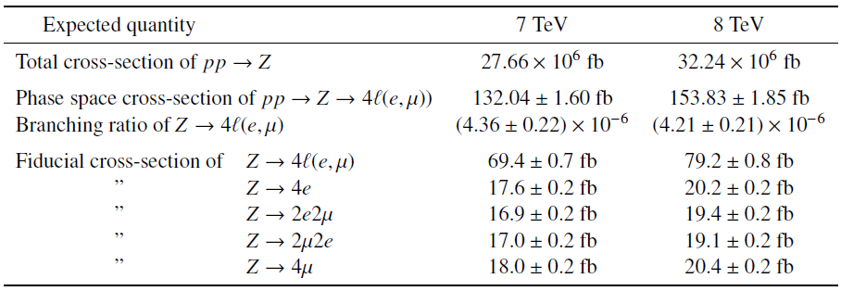
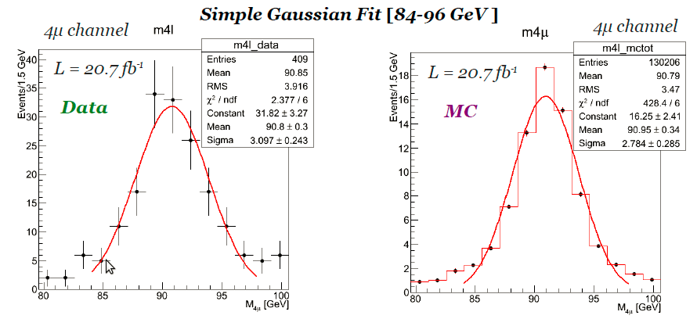
Single Z → 4l Resonance

Slide 16
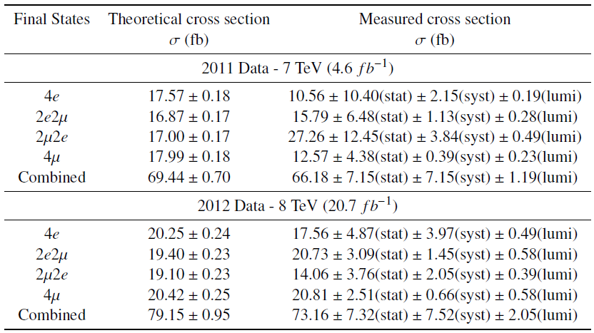
Cross Section of Z → 4l
ATLAS-COM-PHYS-2013-169

Slide 17
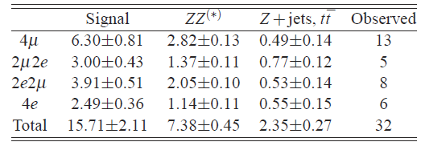
H→ZZ*→4l Events Selection
The number of expected Higgs signal and background events for 4l mass in a ±5 GeV mass window around 125 GeV, for 7 TeV and 8 TeV data.

Slide 18
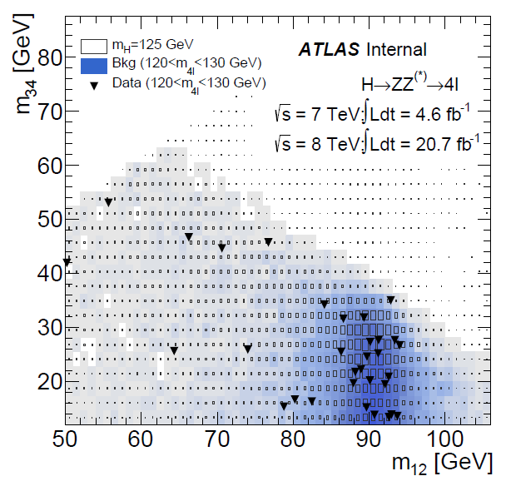
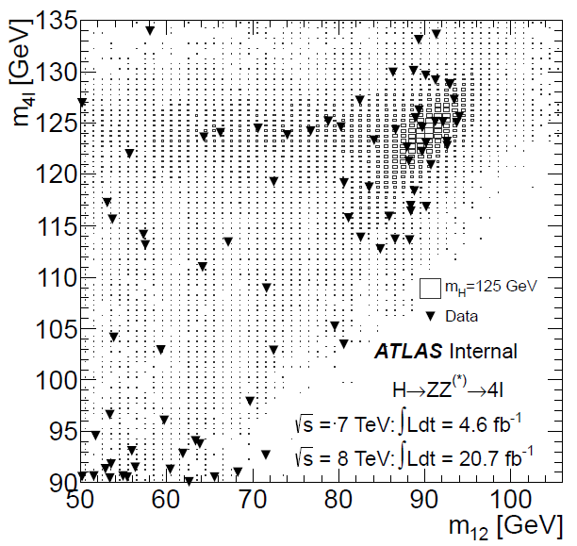
H→ZZ*→4l Candidates
M₁₂ vs M₃₄
M₁₂ vs M_{4l}

Slide 19
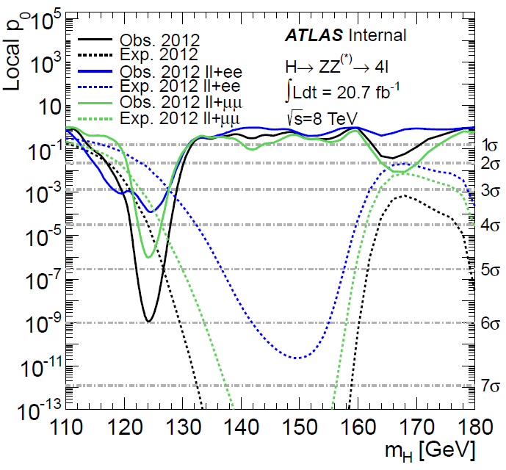
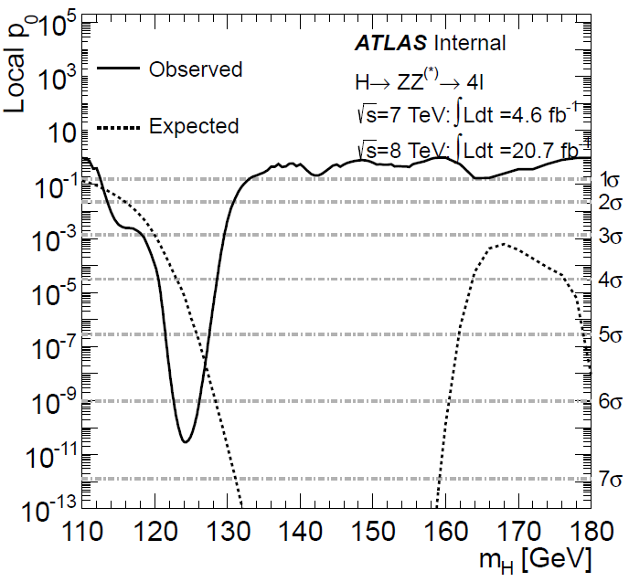
Significance of H→ZZ*→4l

Slide 20
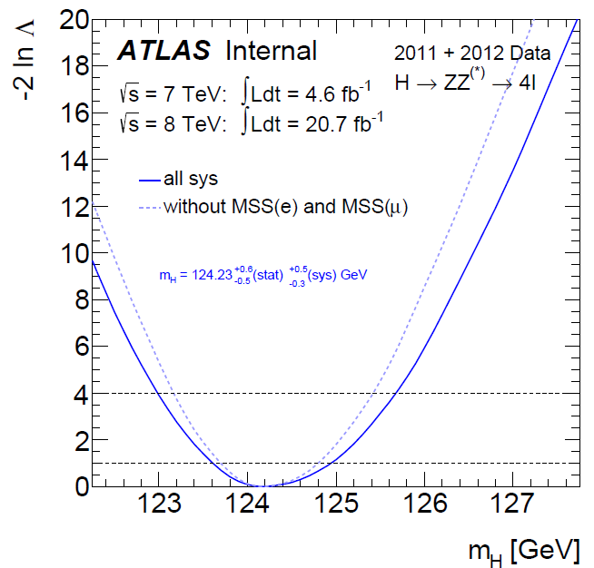
Best Fitted Higgs Mass

Slide 21
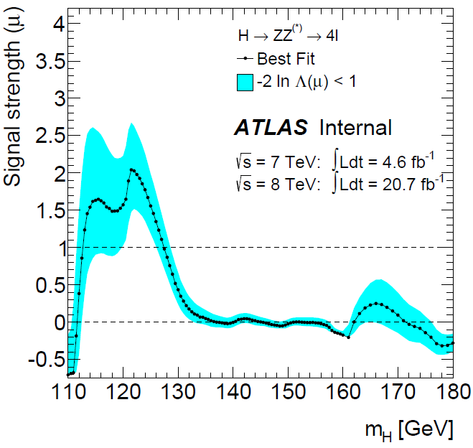
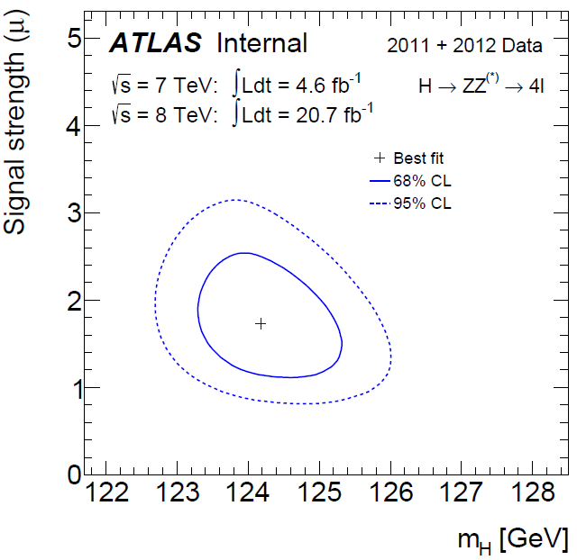
H→ZZ*→4l Signal Strength vs. Mass

Slide 22
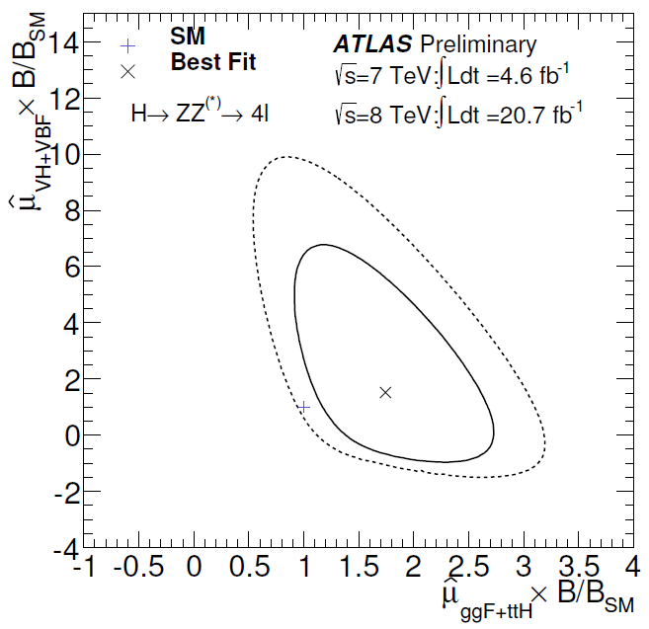
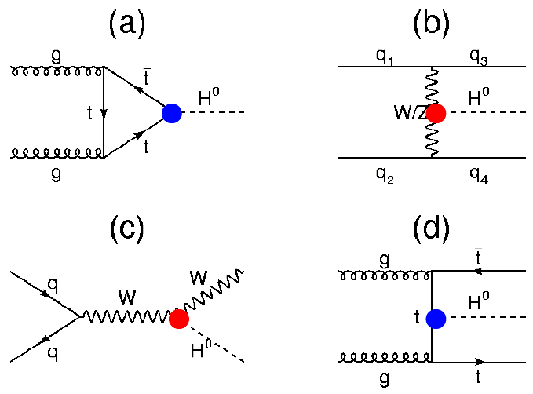
Higgs → ZZ* → 4l
Higgs has two types of couplings
“Gauge” couplings (to bosons)
Yukawa couplings (to fermions)
Explore tension between SM value and observation from different Higgs production modes: μ_{VBF+VH} vs. μ_{ggF+ttH}

Slide 23
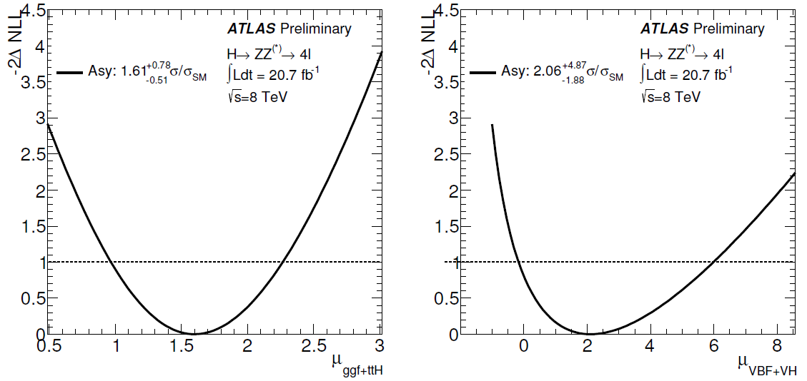
Signal Strength for ggF and VBF Productions
1D projections on the μ_{ggF+ttH} and μ_{VBF+VH} with m_{H} fixed as its best fitted mass.
μ_{ggF+ttH}=1.61+0.78(-0.51) σ/σ_{SM}
μ_{VBF+VH}=2.06+4.87(-1.88) σ/σ_{SM}

Slide 24
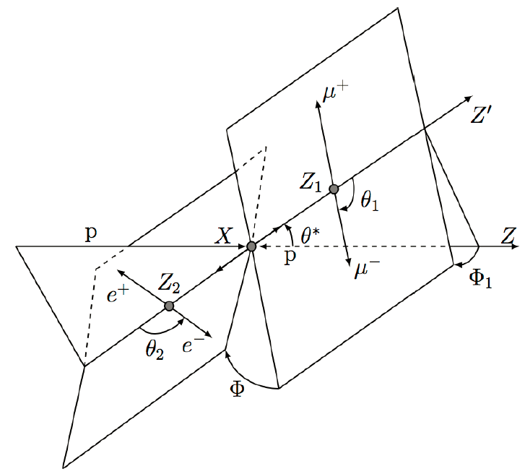
H→ZZ*→4l : Spin and Parity
Fully reconstructed final state allows measuring Spin/CP:
Five kinematic angles (production, decay)
Invariant mass of the primary Z and the secondary Z
Discriminate 0⁺ (SM) hypothesis against:
0⁻ (CP odd), 1⁺, 1⁻
2⁻ (pseudo-tensor)
2⁺_{m} (graviton-like tensor, minimal coupling)

Slide 25
H→ZZ*→4l : Spin and Parity
Two multivariate discriminants used:
Boosted Decision Trees (BDT)
Matrix-Element calculation for each spin / CP (J^{p}-MELA)
Data strongly favour 0⁺ vs 0⁻:
0⁻ hypothesis is excluded at 98.7% C.L., (2.2σ ,expected 2.17σ) ⎝ 0⁺ vs 1⁺ : observed separation 99.9% C.L. (3.05σ, expected 2.31σ)
➔ 0⁺ vs 1⁻ : observed separation 99.6% C.L. (2.66σ, expected 3.86σ)
0⁺ vs 2⁻ : observed separation 78.7% C.L. (0.8σ, expected 2.09σ)
0⁺ vs 2⁺ is excluded at 92.7% C.L. (1.45σ, expected 1.09σ)

Slide 26
Contributions to ATLAS Physics Analyses
H→ZZ→4l Mass, Signal Strength, Spin, Parity etc.
ATLAS-COM-PHYS-2013-144
ATLAS-COM-PHYS-2013-145
ATLAS-COM-PHYS-2013-146
Z→4l Single Resonance Cross Section and BR
ATLAS-COM-PHYS-2013-169

Slide 27
Plan of SJTU Group
Muon New Small Wheel Detector Upgrade
(collaborate with USTC, SDU and UM)
Development of sTGC segment finding algorithm including simulation, look-up table preparation and performance studies
Participation in NSW test beam experiments to study new detector performance and signal characteristics
Liang Li is visiting CERN from March 2 – May 25 for EE chambers installation and NSW simulation work.

Slide 28
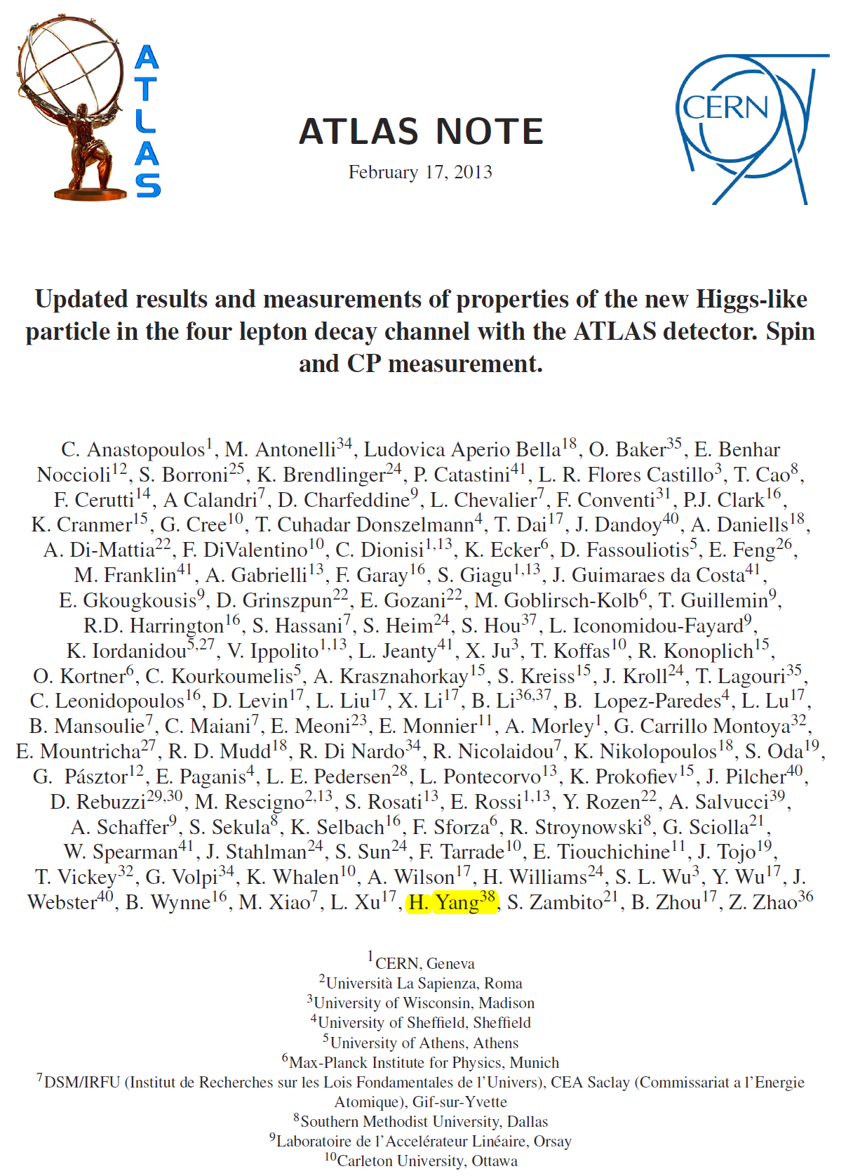
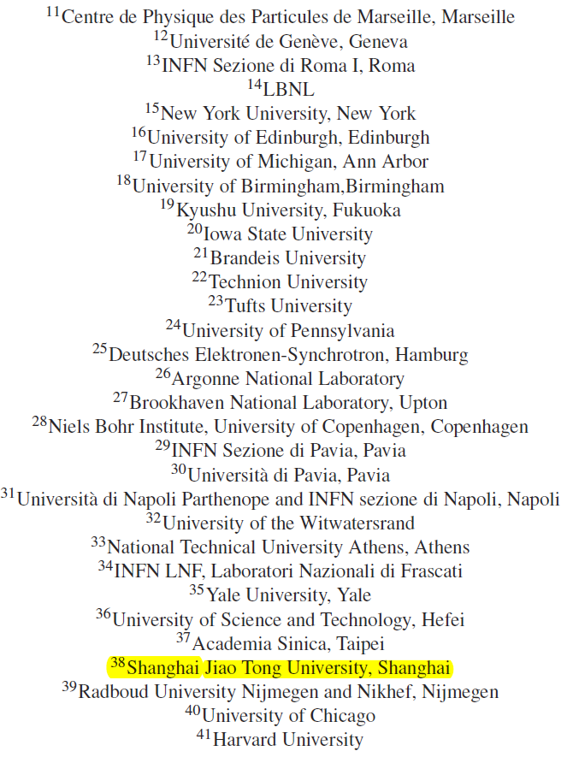

Slide 29
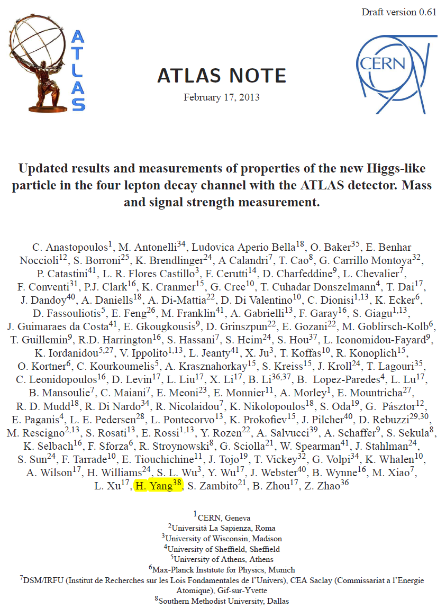
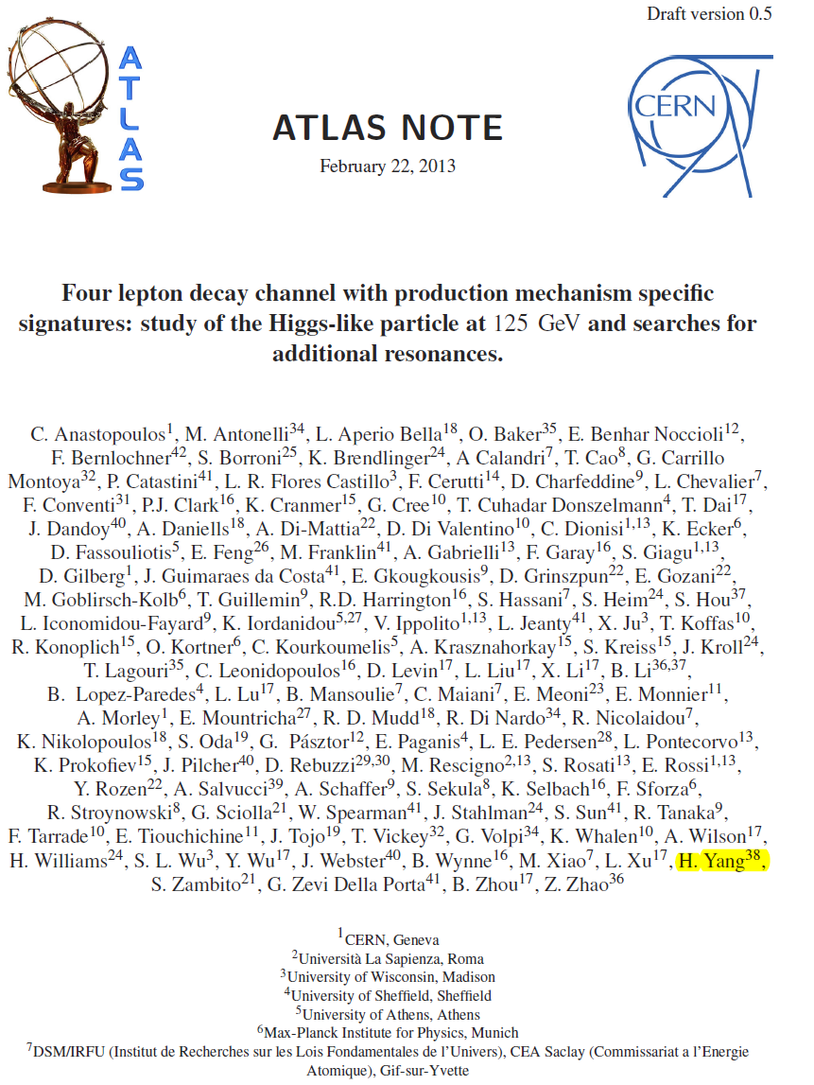

Slide 30
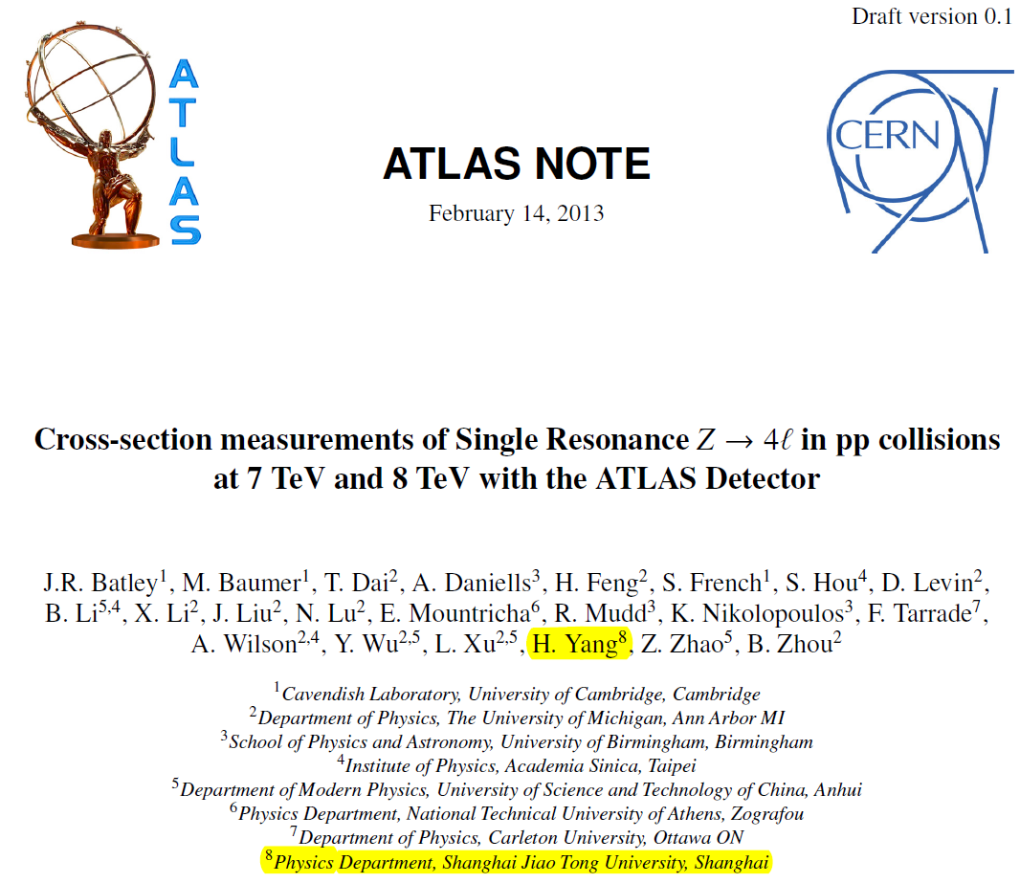

Slide 31
上海交通大学ATLAS实验组招聘
招聘1-2名特别研究员
招聘2名 博士后或助理研究员，从事探测器升级和物理分析
招聘1名计算机管理人员
招收多名研究生和本科生

Slide 32
Backup

Slide 33
Plan of SJTU Group
Physics Analyses:
Search for Higgs via H→ZZ*→4l final states
Determination of Higgs spin and CP using H→ZZ*→4l events
Cross section measurement of single resonant Z→4l
Cross section measurement and aTGC (WW, WZ, ZZ)
Search for new physics using diboson final states
Precise measurements of Single top quark production
New physics search related to top quark production and properties

Slide 34
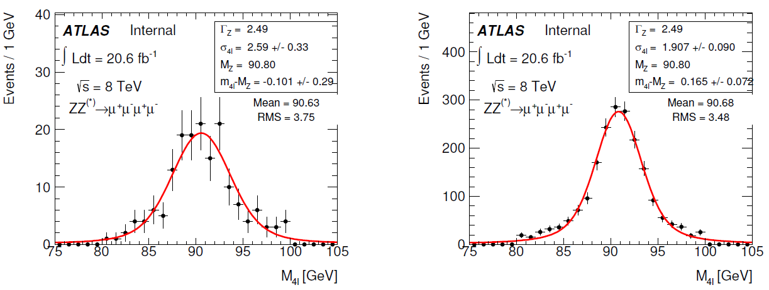
Fit of 4l Mass Distribution
Fit using a Breit-Wigner line shape convoluted with a Gaussian distribution

Slide 35
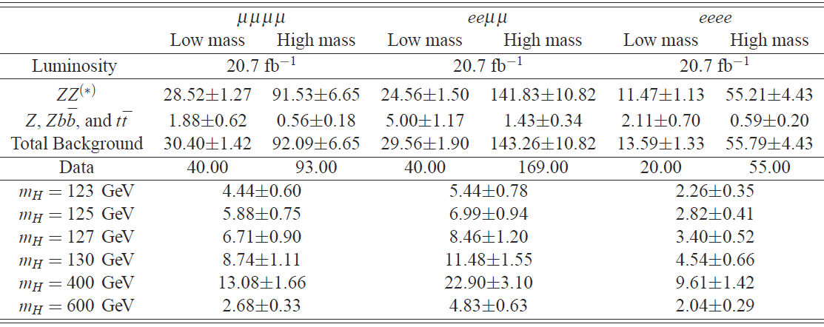
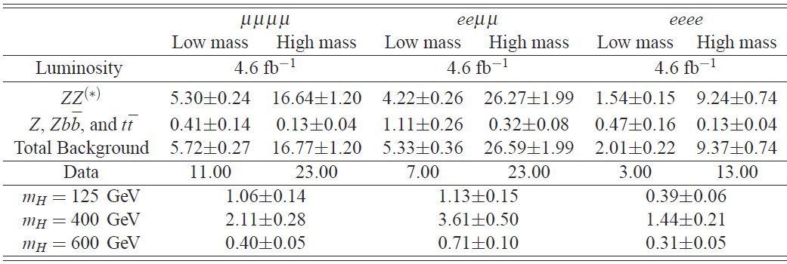
Selected H → ZZ* → 4l Events

Slide 36
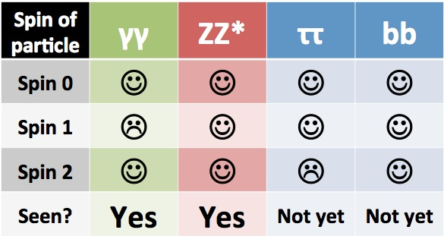
Is it the SM Higgs ?
➔Verify the new observed particle
Spin-0 particle
Spin-1: excluded by H→γγ
Spin-2: look at angular correlations
CP-nature
SM Higgs CP-even, extended Higgs sectors has CP-odd or mixed states
Look at angular correlations
Couplings
Gauge / Yukawa couplings → g_{vvH}, g_{ffH}  m
Unitarity in W_{L}W_{L} scattering → g_{WWH}  m_{W}
Higgs self-couplings, determine shape of Higgs potential via trilinear and quartic couplings, V = μ²|Φ^{|2} + λ|Φ|⁴ + constant

Slide 37
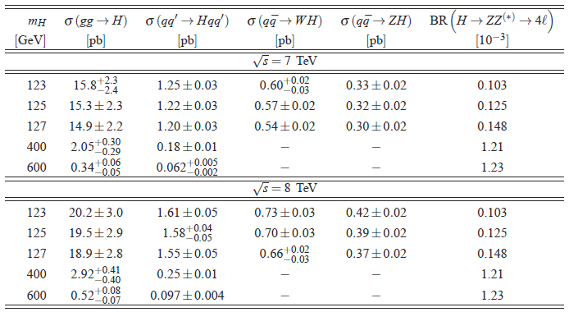
Higgs Production Cross Section and BR

Slide 38
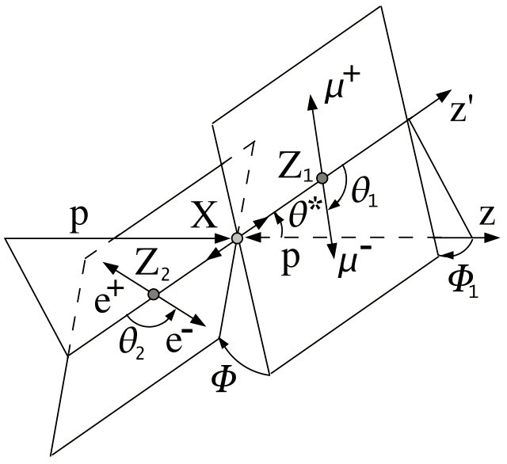
Higgs Spin and Parity Measurement
Variables sensitive to spin and parity
Mass related variables: m_{ZZ}, m_{Z1}/m_{ZZ}, m_{Z2}/m_{ZZ}
Kinematics variables
Pt_{H}, η_{H}, φ_{H,}, lepton pT of second Z (pTl3, pTl4)
ΔR(l₃, l₄), Δη(l₃,l₄), ΔR(Z₁, Z₂)
Angular variables
cosθ₁, cosθ₂, cosθ*, φ₁, φ₂, φ₁₂

Slide 39
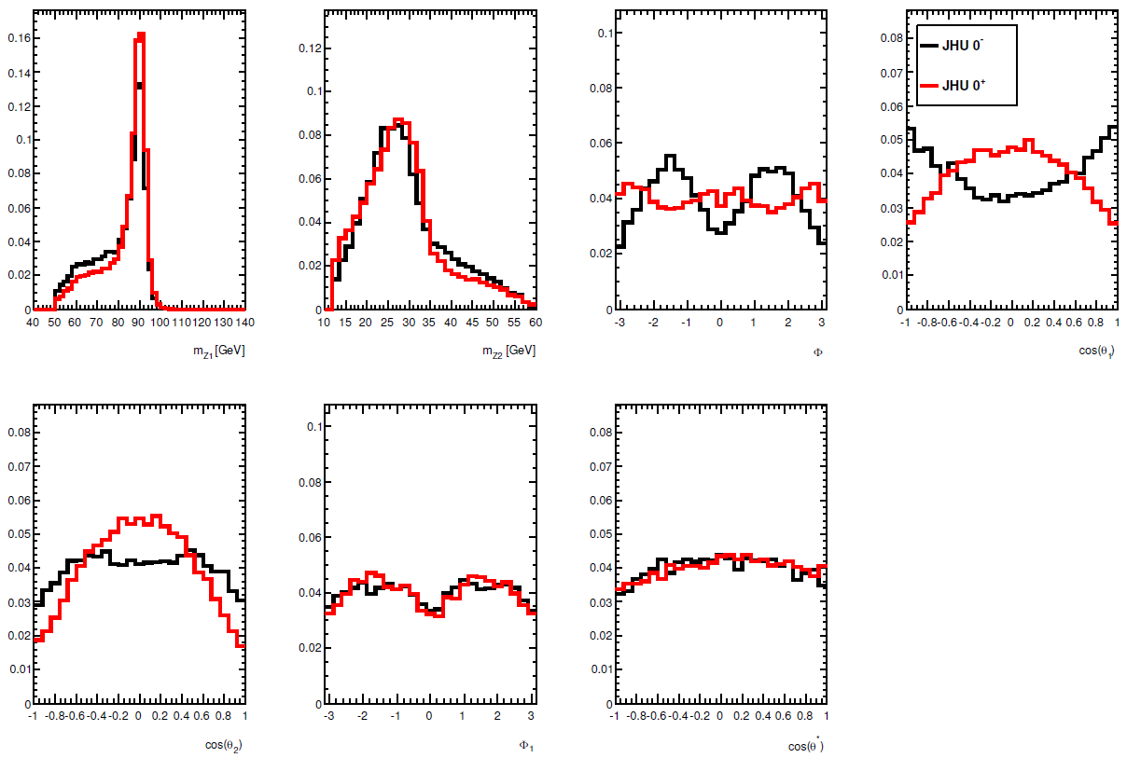
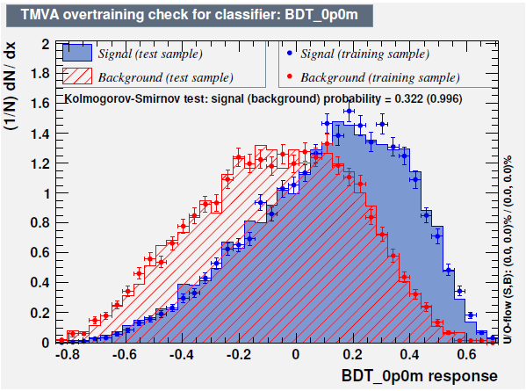
Multivariate Method: BDT
BDT Input / Output

Slide 40
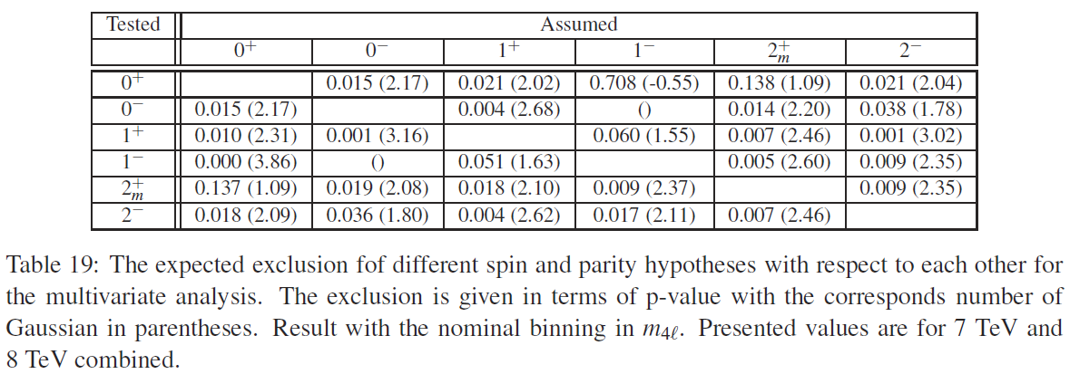
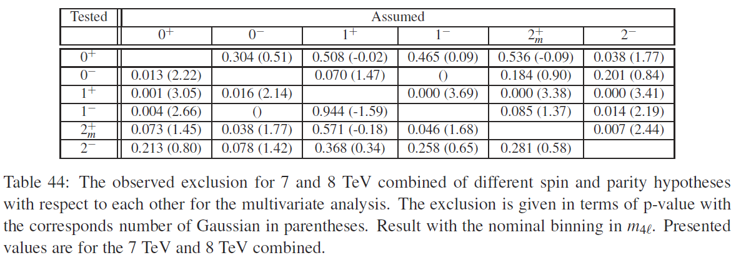
Expected and Observed Exclusions

Slide 41
Contributions to ATLAS Physics Analyses
Search for Higgs through H→ZZ→4l final state
4.7 fb⁻¹(7TeV), ATL-COM-PHYS-2012-530
3.2 fb⁻¹(8TeV), ATL-COM-PHYS-2012-721
5.8 fb⁻¹(8TeV), ATL-COM-PHYS-2012-835
“Observation of a New Particle in the Search for the Standard Model Higgs Boson with the ATLAS Detector at the LHC”, Phys. Lett. B 716 (2012) 1-29
Current works on Higgs spin and CP measurement
Higgs Spin/Parity Determination based on BDT, ATLAS HSG2 MVA Meeting, August 6, 2012
JHU MC Validation and Higgs Spin/Parity Determination based on BDT, ATLAS HSG2 MVA Meeting, July 30, 2012

Slide 42
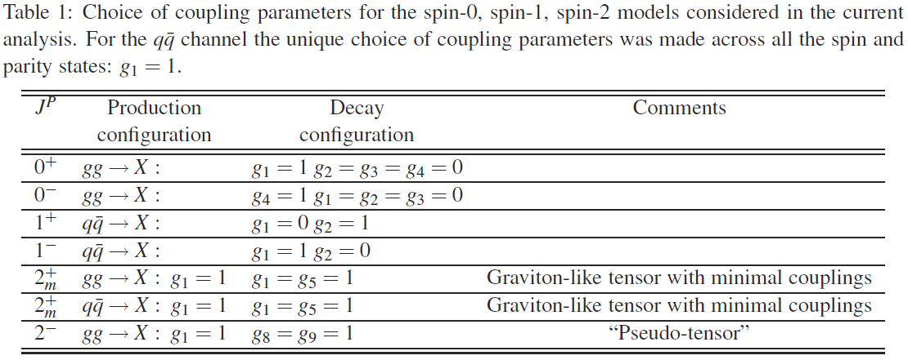
Modeling Spin and Parity States
CP-even and CP-odd resonances with spins 0, 1, and 2 are considered.

Slide 43
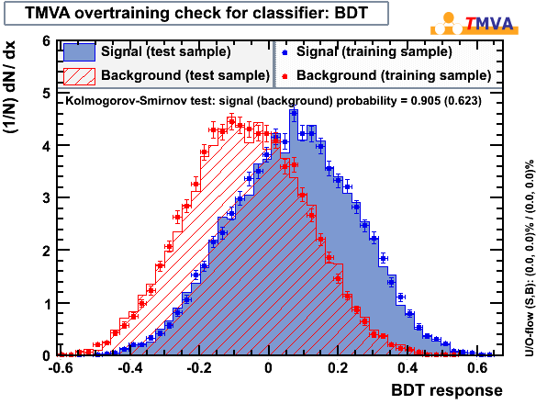
BDT Training and Test Results
About 28K JHU H(0+) and 28K H(0-) events, one half for BDT training and another half and SM ZZ for test.
Selection Cuts:
- 50 GeV < MZ1 < 106 GeV
- 17.5 GeV < MZ2 < 115 GeV
- Lepton pT:
pT1 > 20 GeV, pT2 > 15 GeV,
pT3 > 10 GeV, pT4 > 7 GeV
- |Eta| < 2.5
- dR > 0.1 (0.2) for same (different) flavor di-lepton
- 120 GeV < M_{ZZ} < 130 GeV

Slide 44
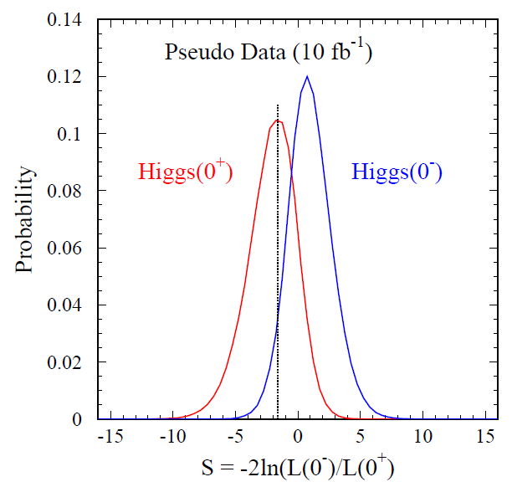
Log-likelihood Ratio and Separation Power
Using Binned Log-likelihood Ratio method to determine the separation power between Higgs 0+ and 0-
1M MC trials based on Poisson statistics
Log-likelihood Ratio distributions
Expected significance vs int. luminosity
Int. Luminosity (fb⁻¹) | Significance (no ZZ, BDT) | Significance (with ZZ, BDT)
10 (N_{s}=6, N_{b}=5.5) | 1.97 σ | 1.45 σ
20 (N_{s}=12, N_{b}=11) | 2.74 σ | 1.98 σ
30 (N_{s}=18, N_{b}=16.5) | 3.36 σ | 2.40 σ
40 (N_{s}=24, N_{b}=22) | 3.85 σ | 2.77 σ
50 (N_{s}=30, N_{b}=27.5) | 4.26 σ | 3.10 σ

Slide 45
Higgs Boson Width
Strong mass dependent
Γ_{H} = 3.5 MeV @ 120 GeV
1.4 GeV @ 200 GeV
8.4 GeV @ 300 GeV
68.0 GeV @ 500 GeV
At low mass region (<200 GeV), detector resolution dominates mass resolution
At high mass, intrinsic width becomes dominant

