Slide 1
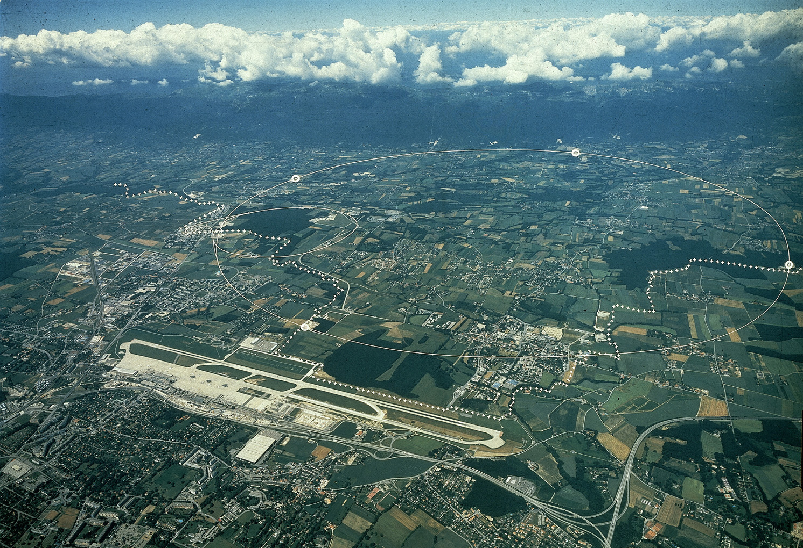
Discovery of Higgs boson at LHC
Haijun Yang
Colloquium at Department of Physics
Shanghai Jiao Tong University
September 12, 2012

Slide 2
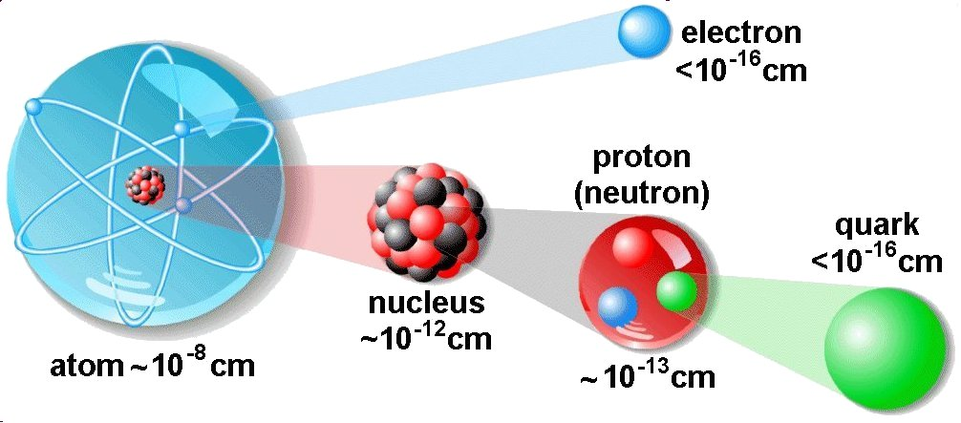
Introduction of Sub-atomic World
Particle Physics studies the properties of fundamental building block of matters and their interactions.

Slide 3
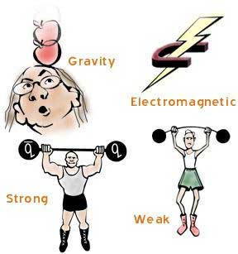
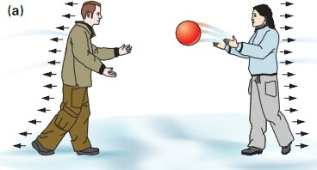
Interactions of Particles
Force is explained by exchange of force carriers between particles (Gravitational, Electromagentic, Strong, Weak)
Long-range force: light force carrier (γ, graviton)
Short-range force: heavy force carrier (W±, Z⁰)

Slide 4

Standard Model of Elementary Particles
Elementary Particles
> 100 years’ discoveries
The SM is in excellent agreement with the numerous experimental measurements.
The only missing SM particle is the Higgs boson which is proposed to responsible for the electroweak symmetry breaking, particles acquire mass when interacting with the Higgs field.
Hunting for the Higgs boson is one of main goals
in particle physics (LEP, Tevatron, LHC)

Slide 5
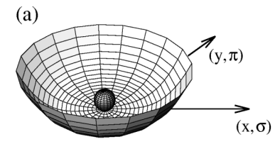
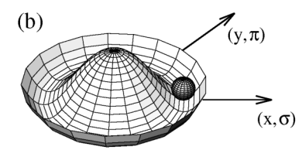
Higgs Mechanism
The potential in (a) is symmetric
The potential in (b) the potential is still symmetric,
but the symmetry of the ground state is spontaneously broken.
Spontaneously symmetry breaking ➔ Nambu-Goldstone bosons (no spin, mass)
Peter Higgs showed that Goldstone bosons need not occur when a local symmetry is spontaneously broken in a relativistic theory. Instead, the Goldstone mode provides the third polarisation of a massive vector field. The other mode of the original scalar doublet remains as a massive spin-zero particle – the Higgs boson.
Z
Z

Slide 6
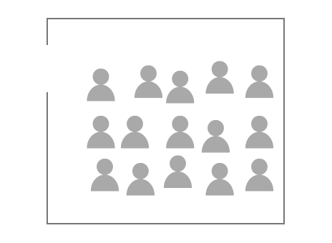
Cartoon Explanation of the Higgs Boson
Physicists
“Higgs field”

Slide 7

Cartoon Explanation of the Higgs Boson
A famous physicist
“Particle”
Physicists
“Higgs field”

Slide 8

Cartoon Explanation of the Higgs Boson
A famous physicist is hard to move across the room.
“Particle” → gain mass
Physicists
“Higgs field”

Slide 9

Cartoon Explanation of the Higgs Boson
A less popular physicist is easier to move across the room.
“Particle” → gain lower mass
Physicists
“Higgs field”
A famous physicist is harder to move across the room.
“Particle” → gain higher mass

Slide 10
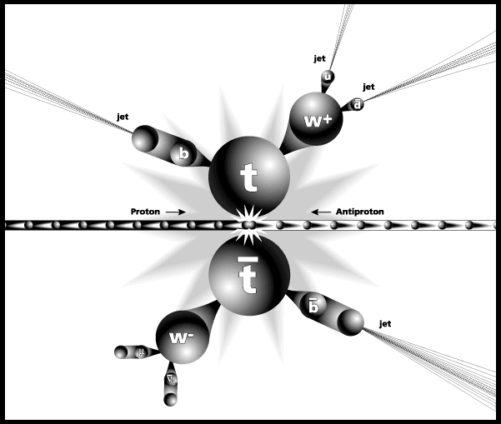
Our Tool: High Energy Collider
Energy is the currency in particle physics !
  Shorter distance ↔ Higher energy (λ=ћ/p)
  Heavier matter particle ↔ Higher energy (E = mc²)
High energy beam and big machine to study the smallest scale
M_{t} = 173.2 GeV/c²
M_{p} = 0.938 GeV/c²
Energy = 0.98 TeV

Slide 11
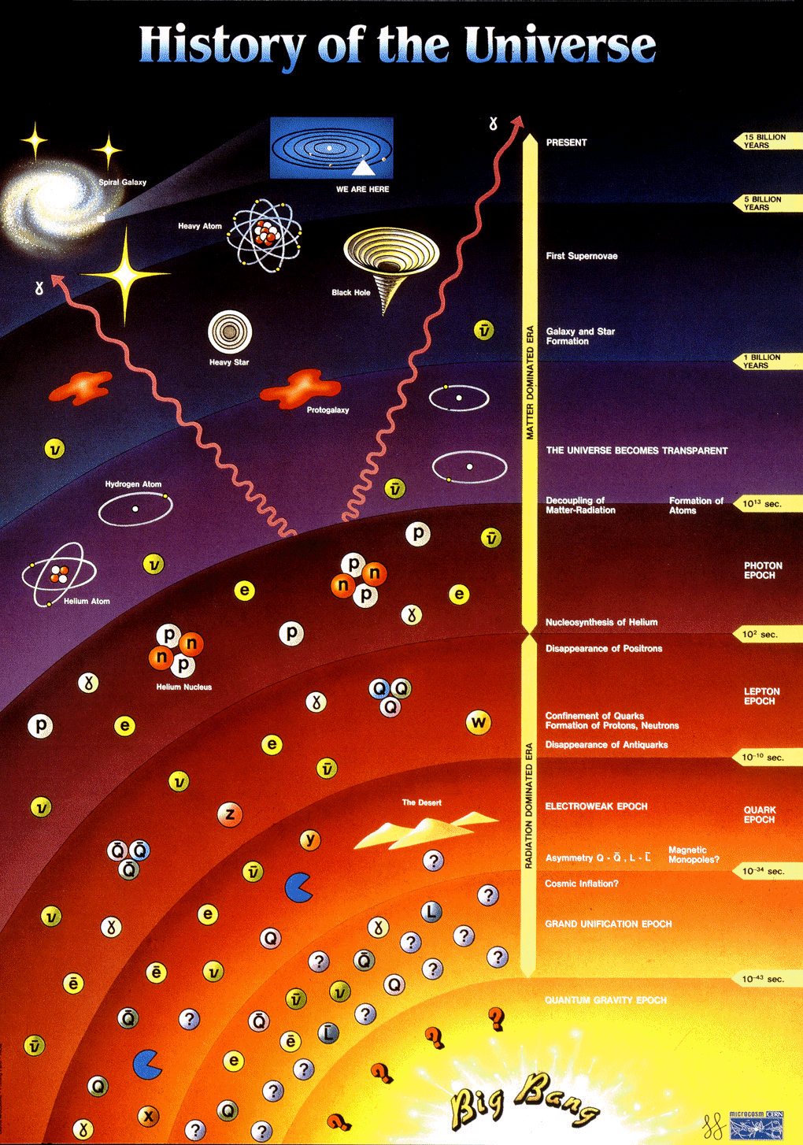
Our Tool: High Energy Collider
Higher energy beam collisions ↔ higher temperature (E = κT)
Use high energy collider to recreate the conditions right after the Big Bang.
Shortest scale in particle physics
Largest scale in the Universe
LHC, time ≈ 10⁻¹³ s, Temp ≈ 10¹⁷ K,
Energy ≈ 8 TeV, distance ≈ 10⁻¹⁹ m

Slide 12
Large Electron Positron Collider at CERN
Search for Higgs boson at LEP (e⁺e⁻, 26.7km)
LEP1 (1989): √s = 91 GeV
LEP2 (2000): √s = 209 GeV
ALEPH
L3
OPAL
DELPHI
where WWW was born in 1991…

Slide 13
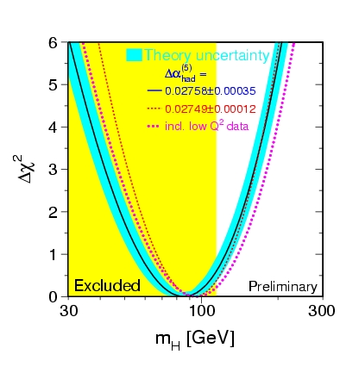
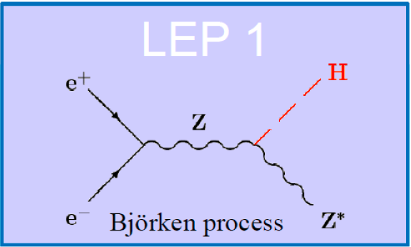
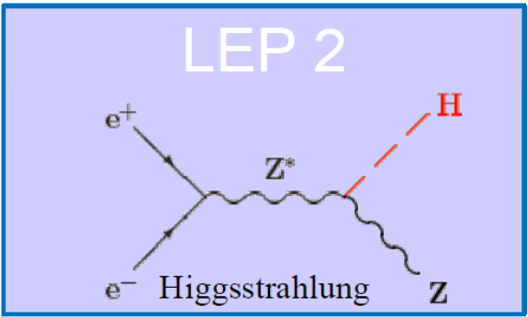
Search for Higgs boson at LEP
➔Results: exclude m_{H} < 114.4 GeV/c² at 95% CL
(Physics Letters B 565 (2003) 61-75)

Slide 14
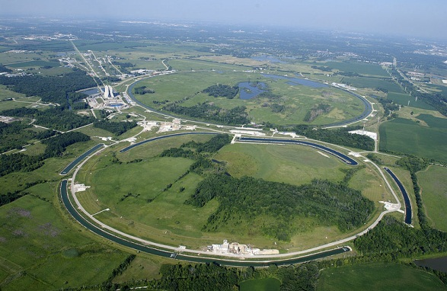
Tevatron at Fermilab (FNAL)
Search for Higgs boson at Tevatron (1.96 TeV): 1983 – 2011
Proton-antiproton collision, 6.3km
CDF
D0

Slide 15
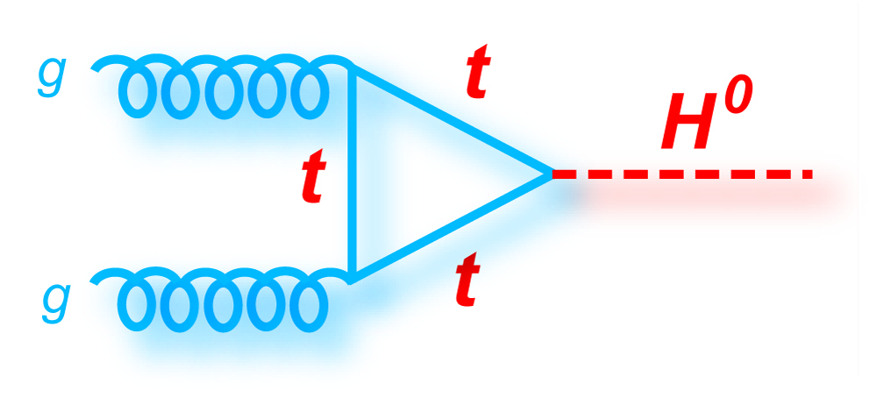
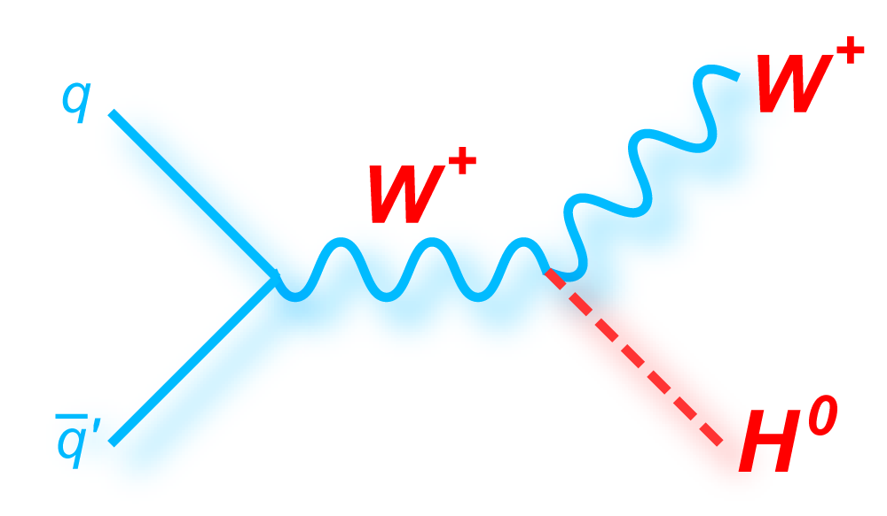
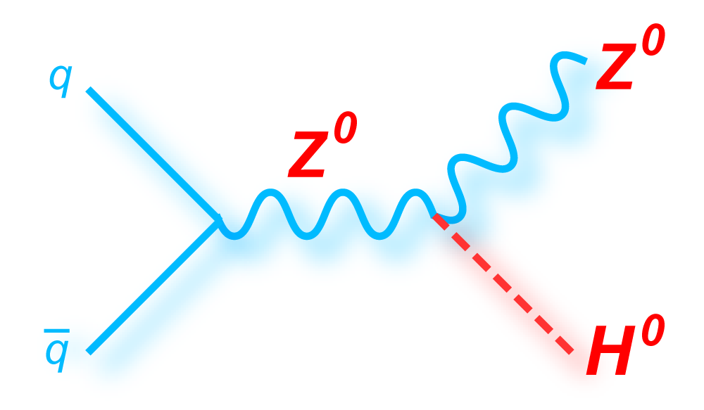
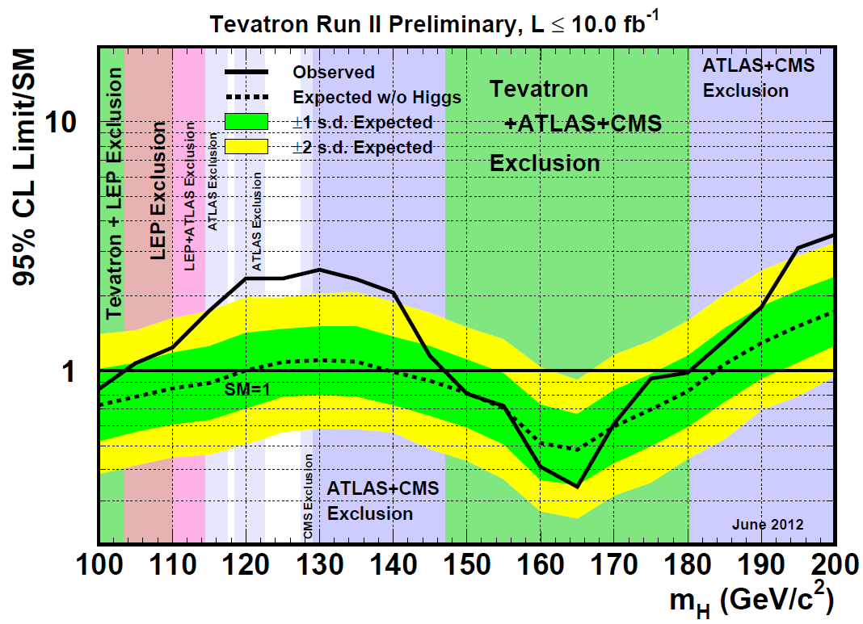
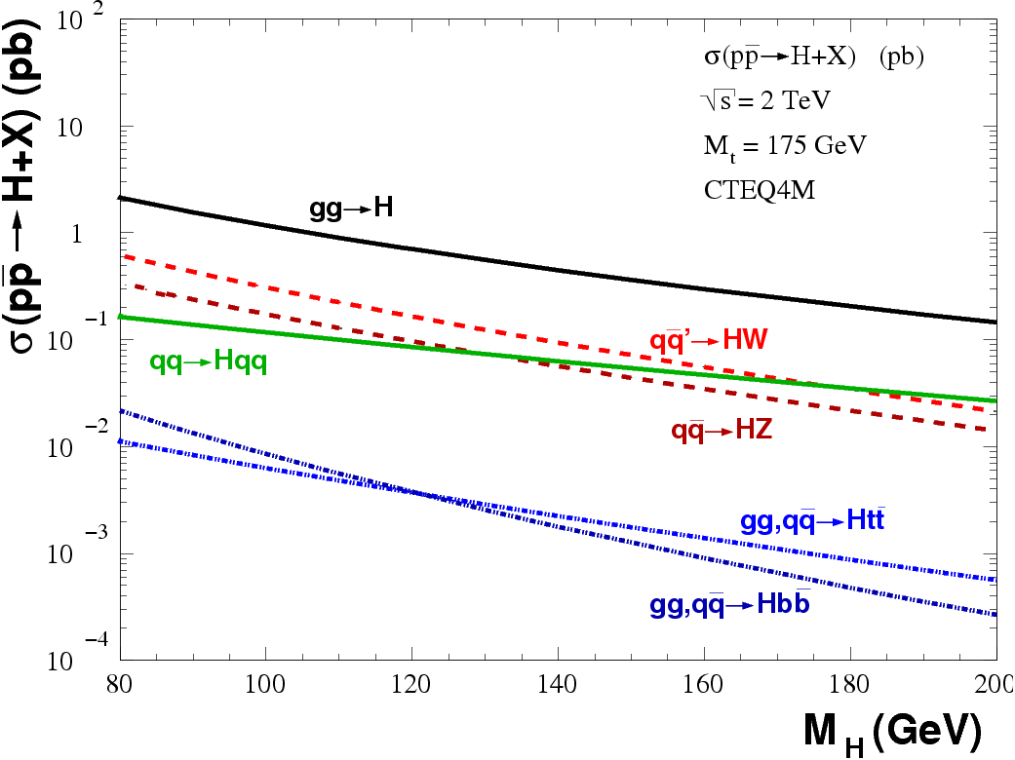
Search for Higgs boson at Tevatron
➔ Results (arXiv:1207.0449): 2.5σ excess at m_{H}=120-130 GeV
~2.5σ excess

Slide 16
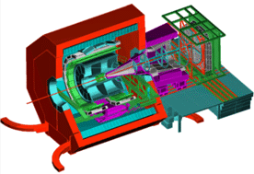
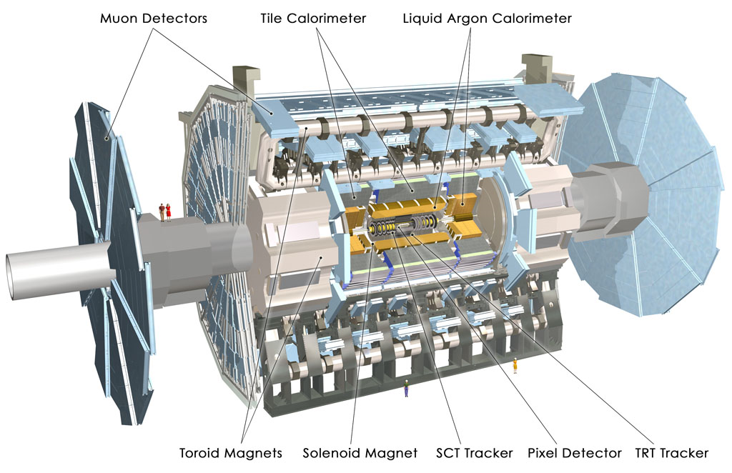

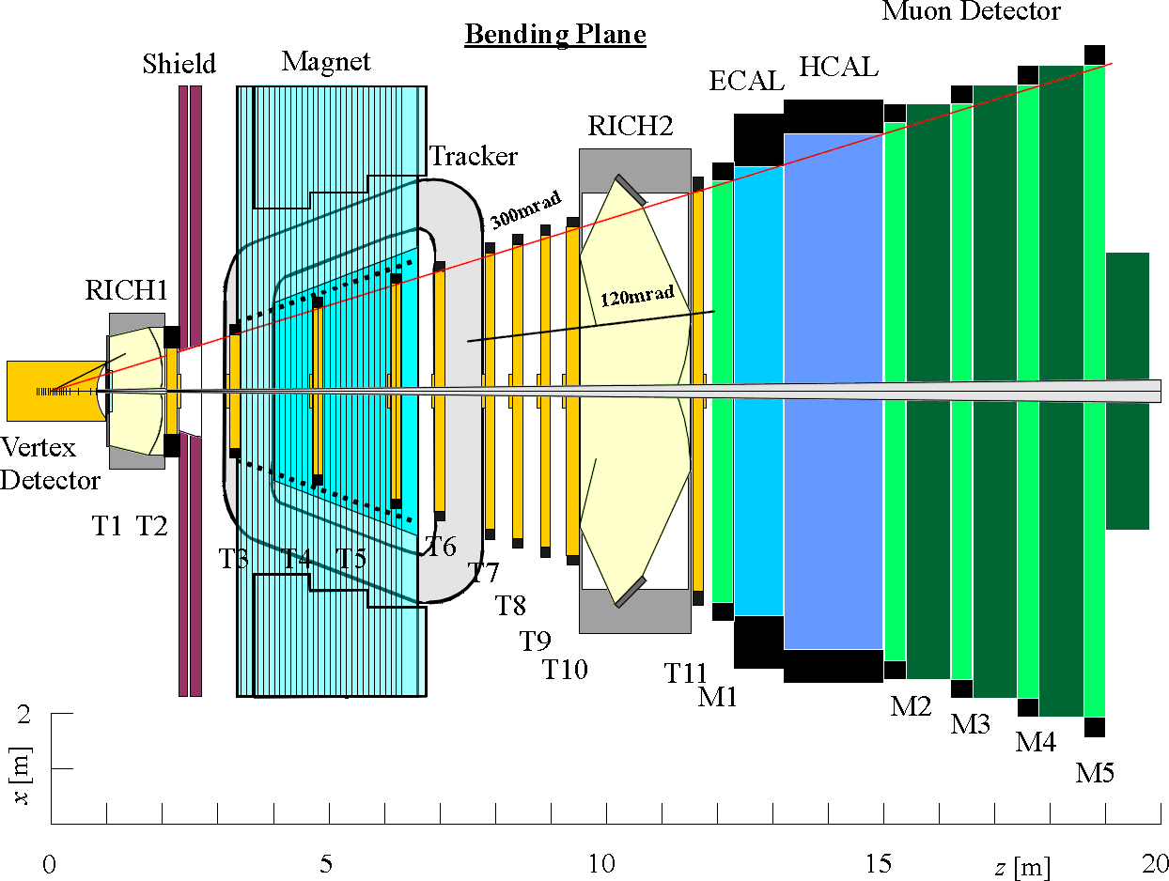
Large Hadron Collider at CERN
ALICE
ATLAS
CERN
CMS
LHCb
LHC: 27 km, world’s largest proton-proton collider (7-14 TeV)

Slide 17
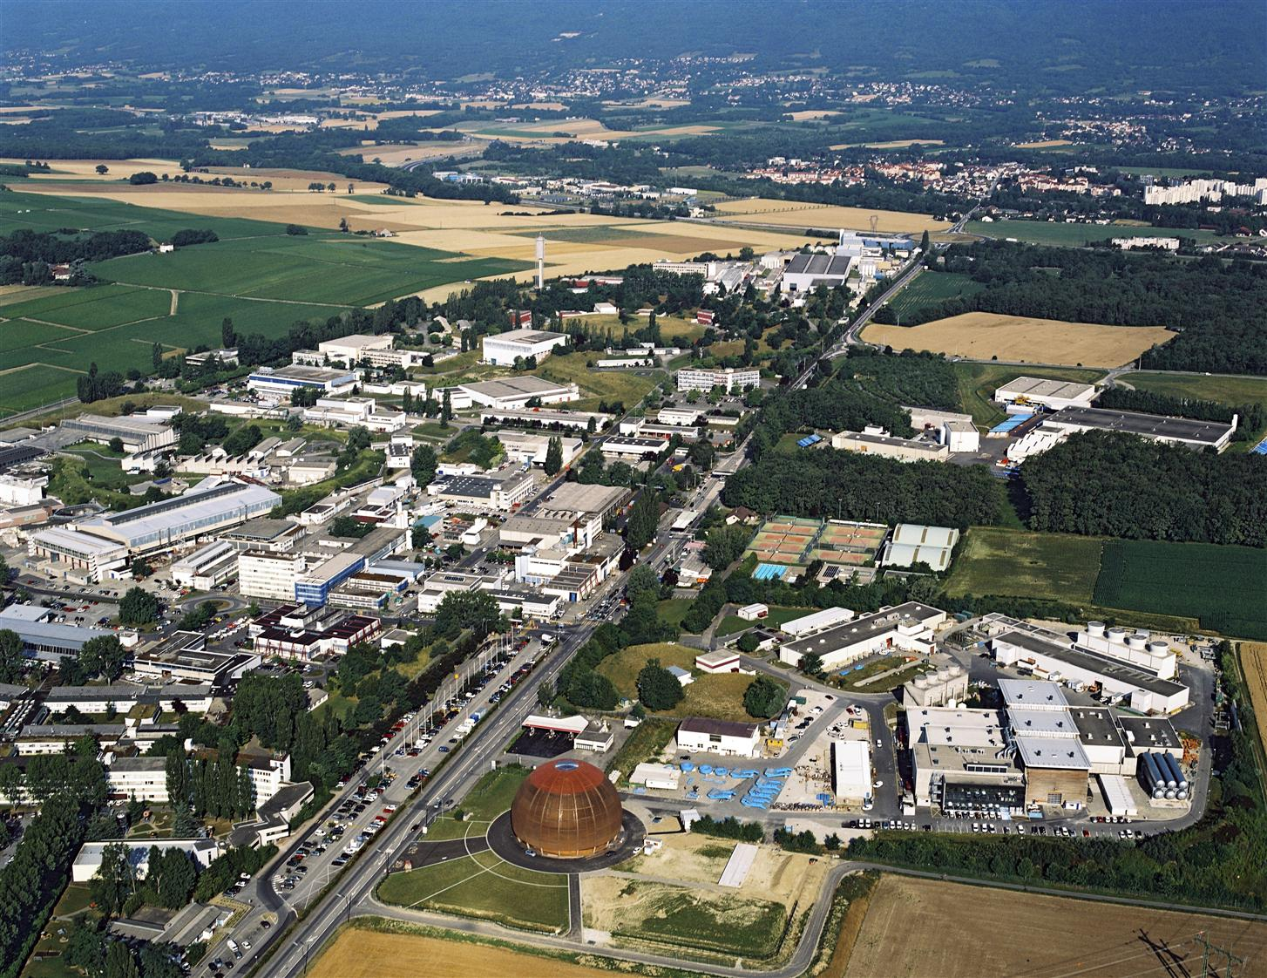
CERN

Slide 18

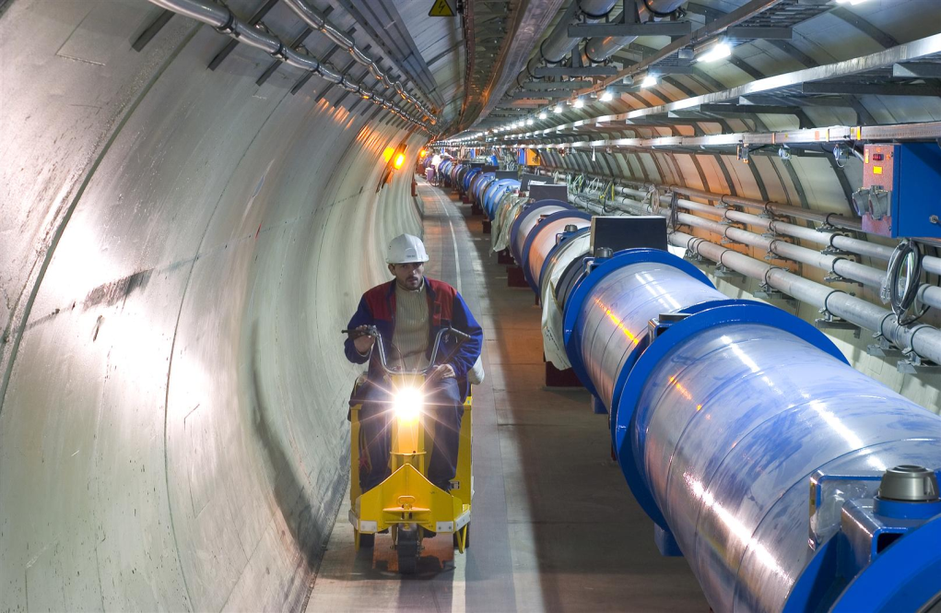
Tunnel (26.7 km)

Slide 19
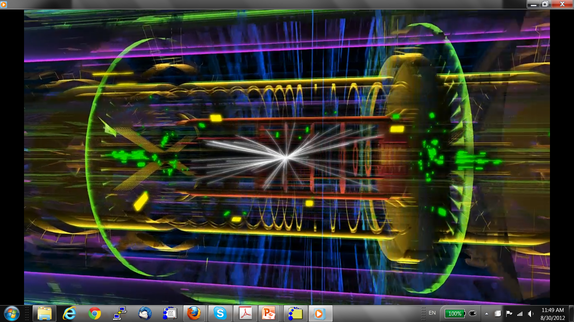
Particle Acceleration and Collision
Proton-proton collision at LHC

Slide 20
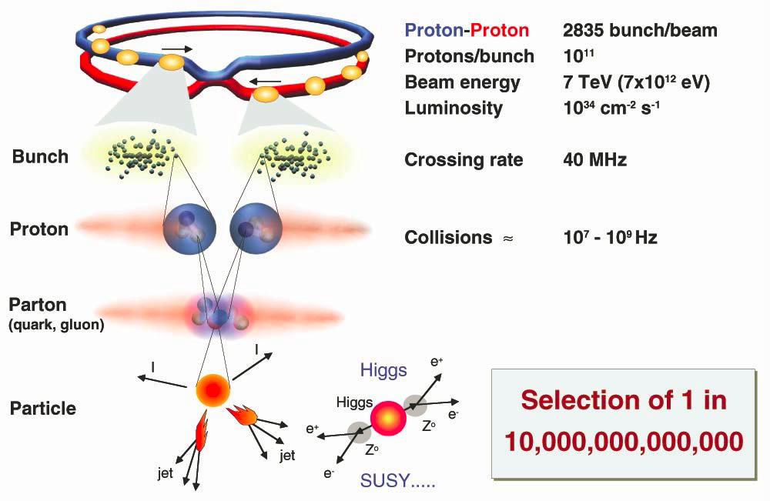
Collisions at LHC

Slide 21
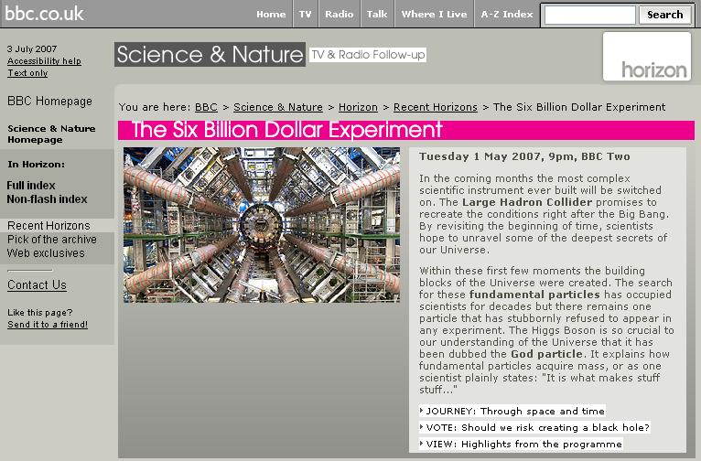
LHC on BBC

Slide 22
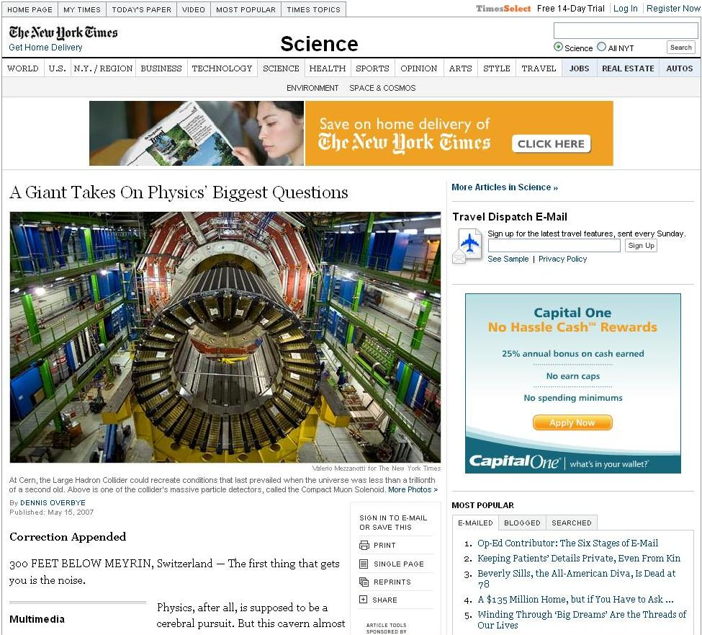
LHC on New York Times

Slide 23
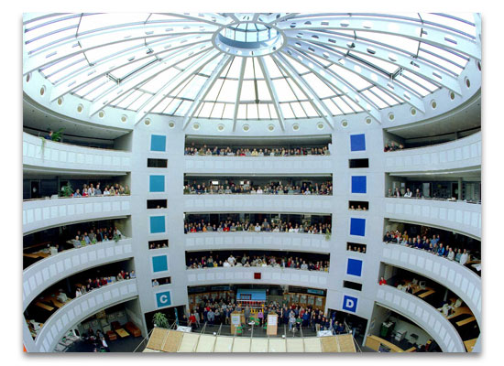
ATLAS and CMS Collaborations
Detector: A Toroidal LHC ApparatuS (ATLAS)
  ~ 3000 physicists
  ~ 1000 students
  175 institutes
  38 countries
Detector: Compact Muon Solenoid (CMS)
  ~ 3300 physicists
  ~ 1500 students
  179 institutes
  41 countries
20+ years of worldwide collaborative efforts

Slide 24
Academic Ranking of World Universities (Top-25)
Ranking of World U. by SJTU (2010) http://www.arwu.org/ARWU2010.jsp
Rank | University Name | Rank | University Name
1 | Harvard U. | 14 | UC, San Diego
2 | UC, Berkeley | 15 | U. Pennsylvania
3 | Stanford U. | 16 | U. Washington
4 | MIT | 17 | U. Wisconsin
5 | U. Cambridge | 18 | John Hopkins U.
6 | Caltech | 19 (no physics) | UC, San Francisco
7 | Princeton U. | 20 | U. Tokyo
8 | Columbia U. | 21 | U. College London
9 | U. Chicago | 22 | U. Michigan
10 | U. Oxford | 23 | Swiss Federal Inst. of Technology, Zurich
11 | Yale U. | 24 | Kyoto U.
12 | Cornell U. | 25 | UIUC
13 | UC, Los Angeles | 26 | Imperial College

Slide 25
ATLAS Member Institutes
Ranking of World U. by SJTU (2010) http://www.arwu.org/ARWU2010.jsp
Rank | University Name | Rank | University Name
1 (ATLAS) | Harvard U. | 14 | UC, San Diego
2 (ATLAS) | UC, Berkeley | 15 (ATLAS) | U. Pennsylvania
3 (ATLAS) | Stanford U. | 16 (ATLAS) | U. Washington
4 (ATLAS) | MIT | 17 (ATLAS) | U. Wisconsin
5 (ATLAS) | U. Cambridge | 18 | John Hopkins U.
6 | Caltech | 19 (no physics) | UC, San Francisco
7 | Princeton U. | 20 (ATLAS) | U. Tokyo
8 (ATLAS) | Columbia U. | 21 (ATLAS) | U. College London
9 (ATLAS) | U. Chicago | 22 (ATLAS) | U. Michigan
10 (ATLAS) | U. Oxford | 23 | Swiss Federal Inst. Of Technology, Zurich
11 (ATLAS) | Yale U. | 24 (ATLAS) | Kyoto U.
12 | Cornell U. | 25 (ATLAS) | UIUC
13 | UC, Los Angeles | 26 | Imperial College

Slide 26
ATLAS and CMS Member Institutes
Ranking of World U. by SJTU (2010) http://www.arwu.org/ARWU2010.jsp
Rank | University Name | Rank | University Name
1 (ATLAS) | Harvard U. | 14 (CMS) | UC, San Diego
2 (ATLAS) | UC, Berkeley | 15 (ATLAS) | U. Pennsylvania
3 (ATLAS) | Stanford U. | 16 (ATLAS) | U. Washington
4 (ATLAS,CMS) | MIT | 17 (ATLAS,CMS) | U. Wisconsin
5 (ATLAS) | U. Cambridge | 18 (CMS) | John Hopkins U.
6 (CMS) | Caltech | 19 (no physics) | UC, San Francisco
7 (CMS) | Princeton U. | 20 (ATLAS) | U. Tokyo
8 (ATLAS) | Columbia U. | 21 (ATLAS) | U. College London
9 (ATLAS) | U. Chicago | 22 (ATLAS) | U. Michigan
10 (ATLAS) | U. Oxford | 23 (CMS) | Swiss Federal Inst. Of Technology, Zurich
11 (ATLAS) | Yale U. | 24 (ATLAS) | Kyoto U.
12 (CMS) | Cornell U. | 25 (ATLAS) | UIUC
13 (CMS) | UC, Los Angeles | 26 (CMS) | Imperial College

Slide 27
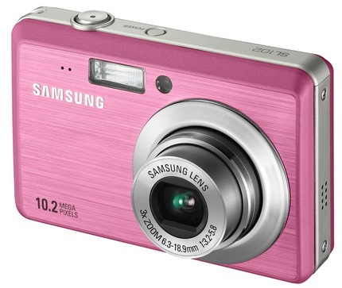
The ATLAS Detector: Huge Camera
Taking pictures at a
rate of 40 Millon/s and
recording pictures at a
rate of ~1000/second
46 x 25 x 25 m, 7000 tons
~3000 collaborators

Slide 28
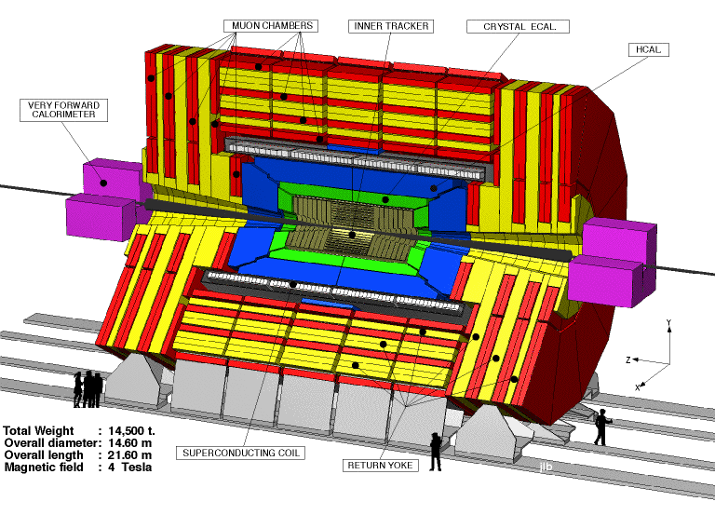
The CMS Detector
Compact Muon Solenoid:
21 x 15 x 15 m, 14,500 tons

Slide 29
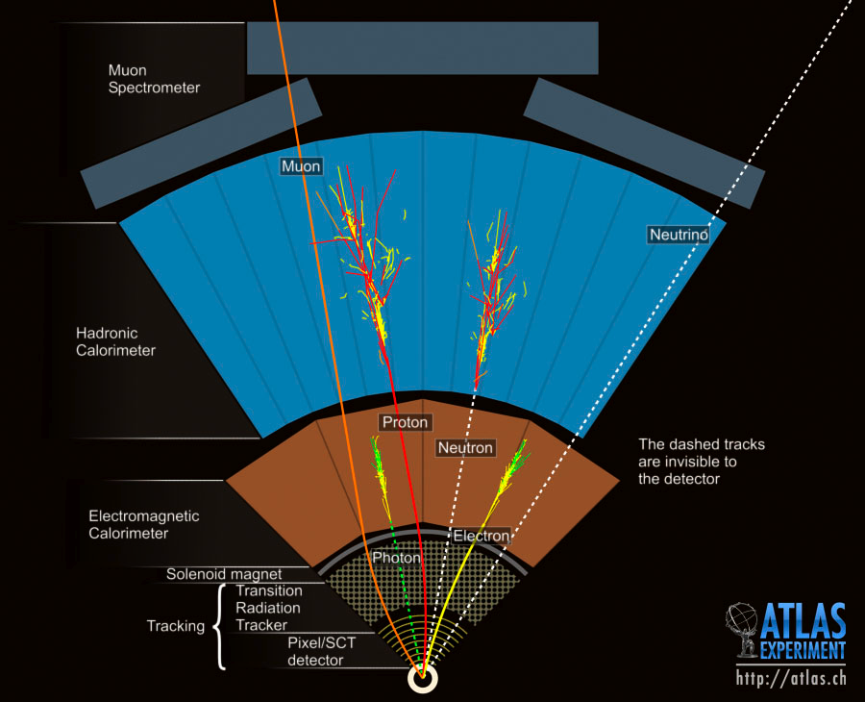
Particle Detection
Different particles have different signatures in detectors
Muon Spectrometer:
muon identification and momentum measurement
Hadronic calorimeter:
Measurement of jets and missing energy
Electromagnetic calo:
e/γ identification and energy measurement
Tracking system:
Charged particle momentum, vertexing

Slide 30
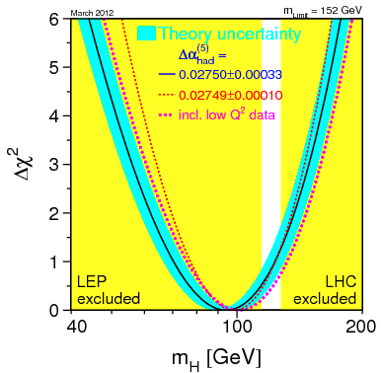

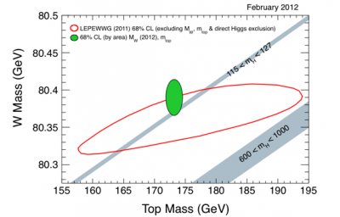

Higgs Boson Mass Constraint
Direct searches at LEP (2000):
m_{H} > 114.4 GeV @ 95% C.L.
Direct search at LHC (2012.3)
m_{H} < 127 GeV @ 95% C.L.
Precision electroweak data are sensitive to Higgs mass, global fit mass:
M²_{W}=M²_{Z}(1-sin²θ_{w})(1+Δρ)
Radiative correction: Δρ(m_{t},m_{H},α,…)

Slide 31
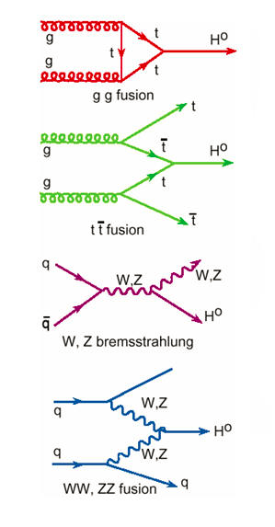
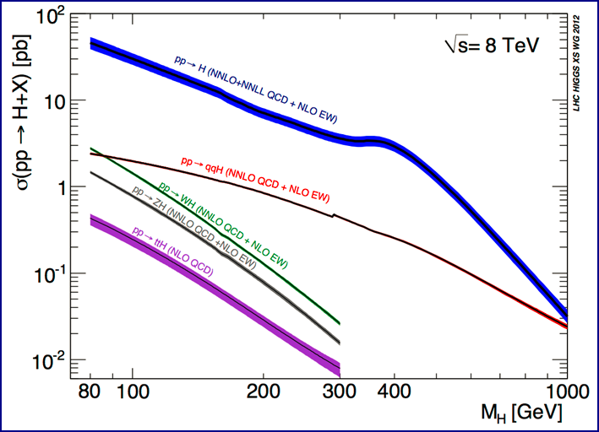
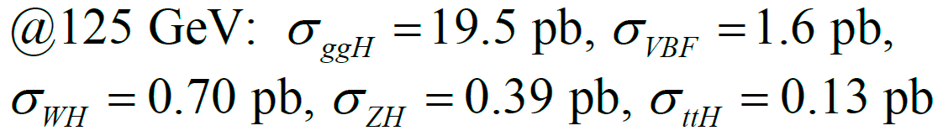
Higgs Boson Production at LHC
Gluon-gluon fusion gg→H and vector-boson
fusion qq→qqH are dominant
Yukawa
coupling
Gauge
coupling
Inelastic pp cross section at 7 TeV is ~ 60 mb

Slide 32
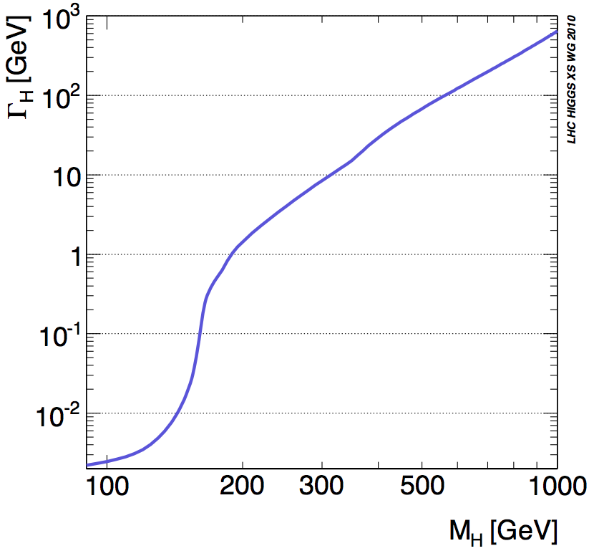
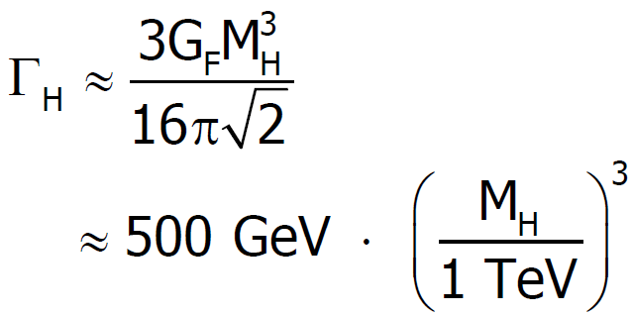
Higgs Boson Width
Strong mass dependent
Γ_{H} = 3.5 MeV @ 120 GeV
1.4 GeV @ 200 GeV
8.4 GeV @ 300 GeV
68.0 GeV @ 500 GeV
At low mass region (<200 GeV), detector resolution dominates mass resolution
At high mass, intrinsic width becomes dominant

Slide 33
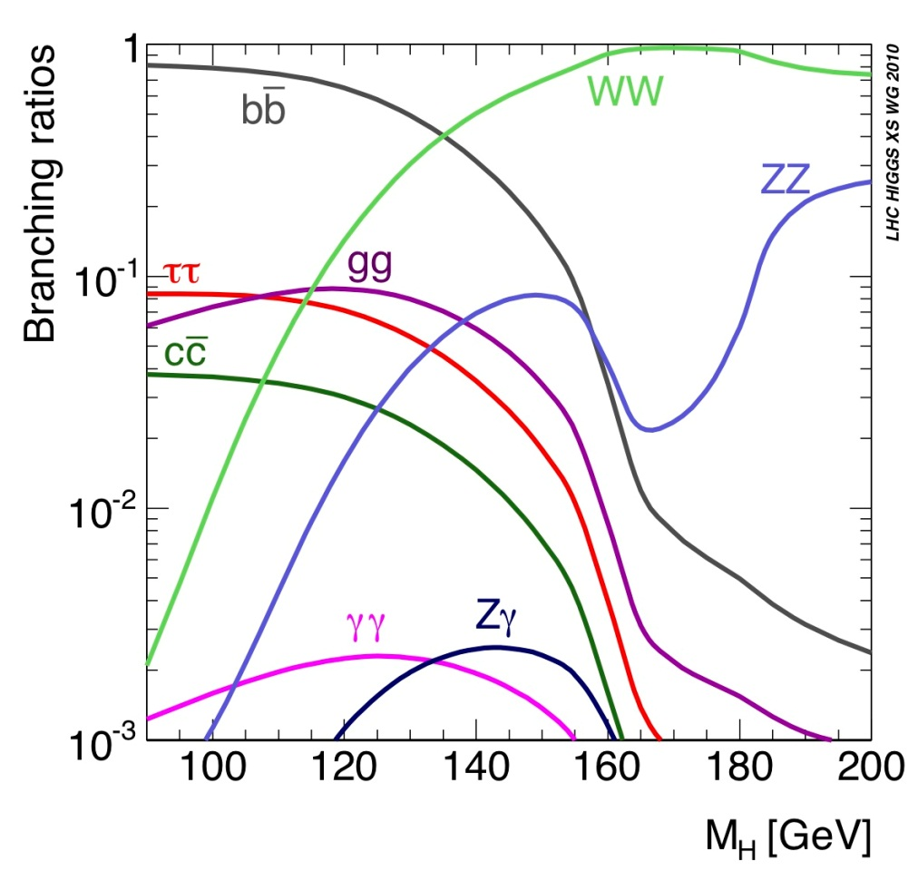
Higgs Boson Decay
Higgs decay branching
ratio at m_{H}=125 GeV
bb: 57.7% (huge QCD background)
WW: 21.5% (easy identification in di-lepton mode, complex background)
ττ: 6.3% (complex final states with τ leptonic and/or hadronic decays)
ZZ*: 2.6% (“golden-plate”, clean signature of 4-lepton, high S/B, excellent mass peak)
γγ: 0.23% (excellent mass resolution, high sensitivity)
Higgs boson production rate:
1 out of 10¹² collision events

Slide 34
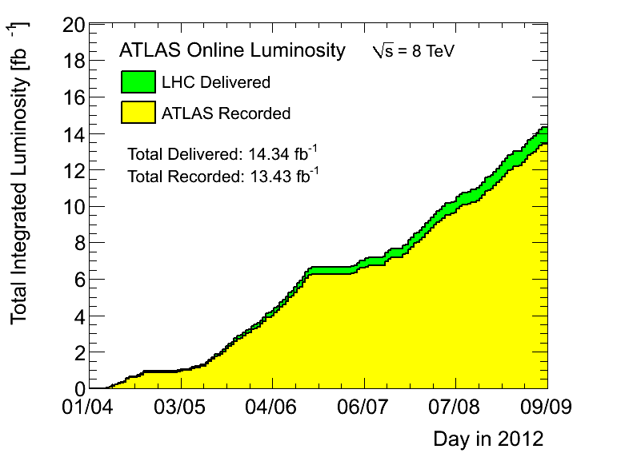
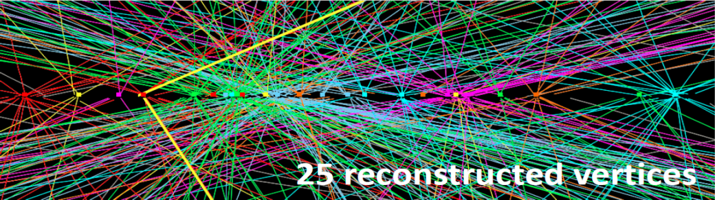
ATLAS Data Samples
7 TeV data samples (2011)
  4.8 fb⁻¹ for physics analysis
  Peak luminosity 3.6×10³³cm⁻²s⁻¹
8 TeV data samples (2012)
  5.8 fb⁻¹ for physics analysis
  Peak luminosity 6.8×10³³cm⁻²s⁻¹
Data-taking efficiency: ~94%
Significant pileup events
ICHEP dataset

Slide 35
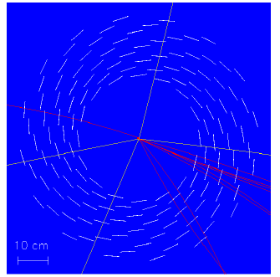
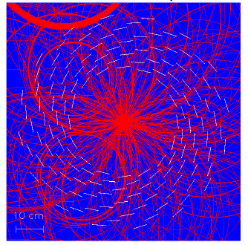
Major Challenge
Large pileup events result in big challenge to the detector, reconstruction and particle identification !
H→ZZ→4μ
μ
μ
μ
μ

Slide 36
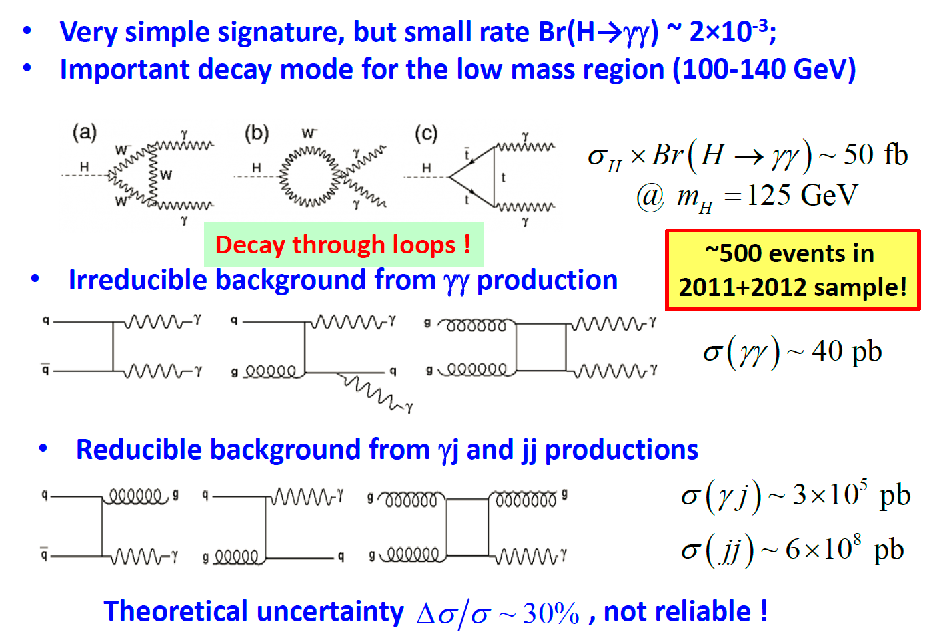
Higgs → γγ

Slide 37
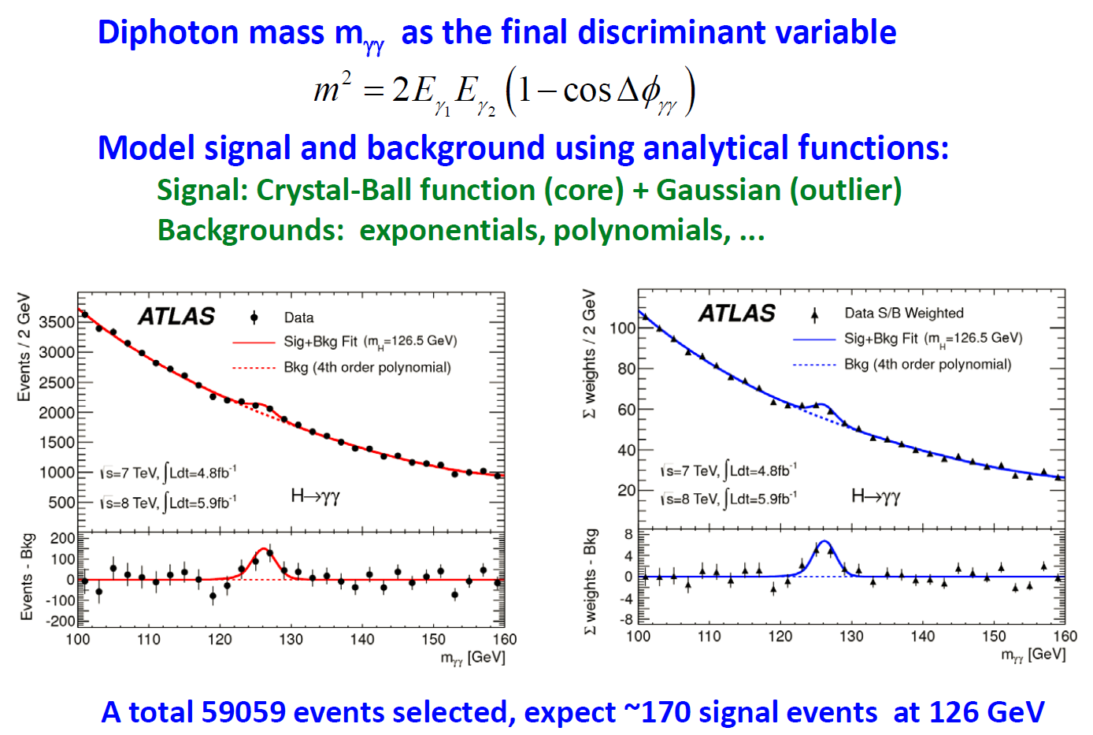
Higgs → γγ

Slide 38
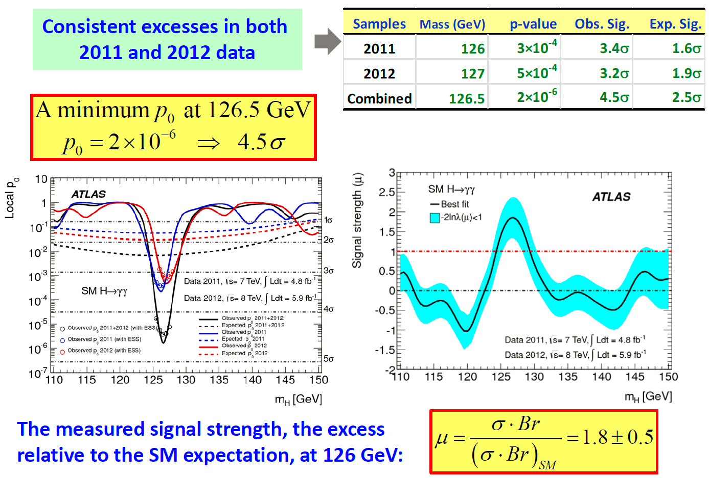
Higgs → γγ

Slide 39
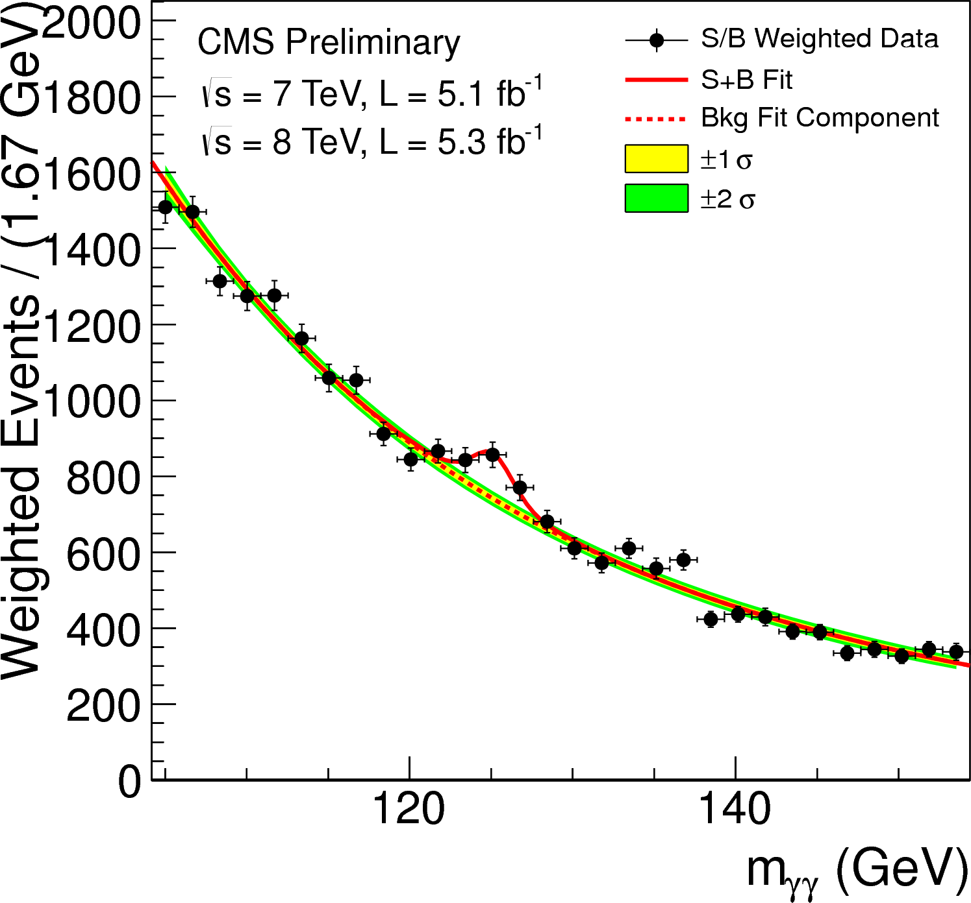
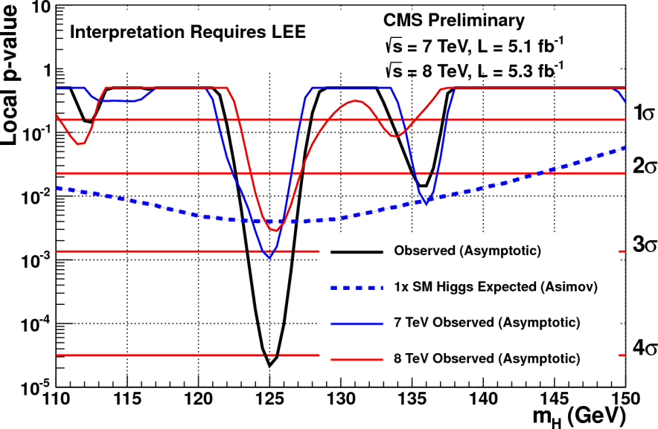
Results from CMS ( H→γγ)
➔ Expected 2.5 σ
Observed 4.1σ (LEE, 3.2σ)
Signal strength:
σ/σ_{SM} = 1.56 ±0.43

Slide 40

Results from CMS ( H→γγ)
➔ Expected 2.5 σ
Observed 4.1σ (LEE, 3.2σ)
Signal strength:
σ/σ_{SM} = 1.56 ±0.43

Slide 41
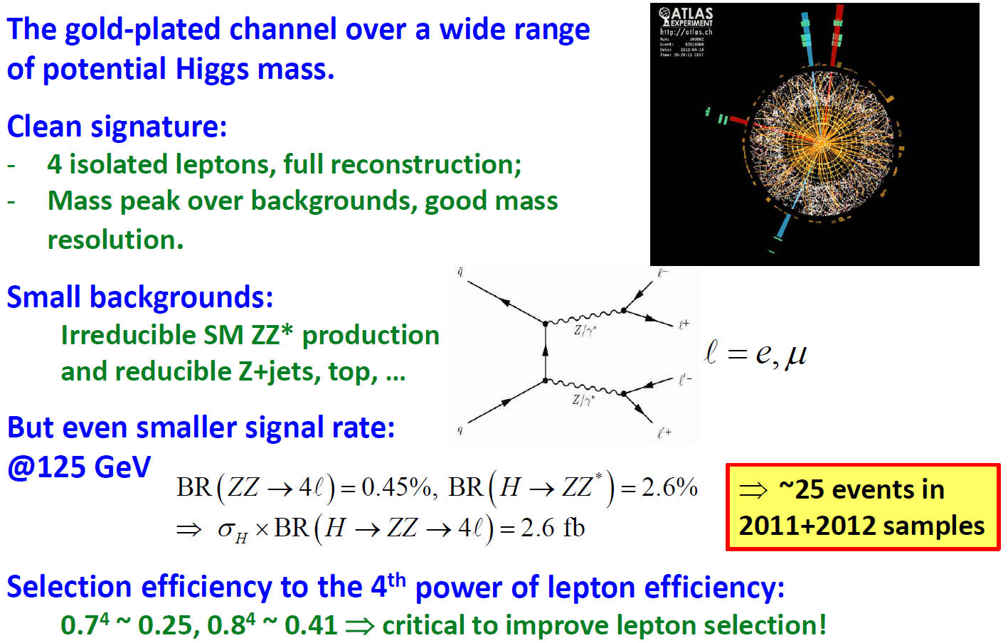
Higgs → ZZ* → 4l: the golden channel

Slide 42
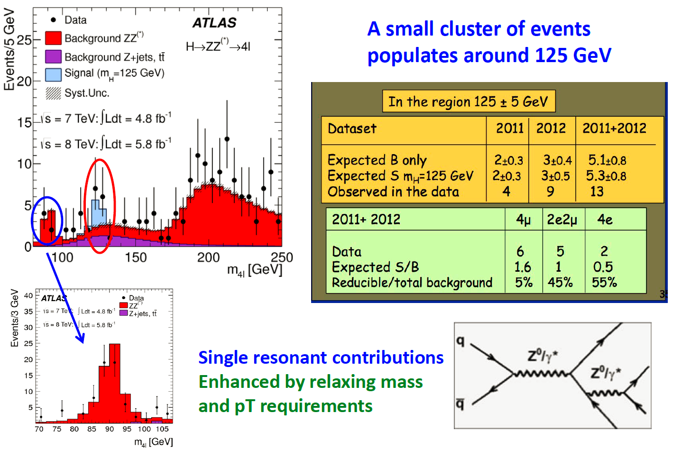
Higgs → ZZ* → 4l

Slide 43

Higgs → ZZ* → 4l

Slide 44

Results from CMS (H→ZZ*→4l)
Enrich the Higgs signal by
tightening the selection cuts
Single resonant Z→4l using
loose selection cuts
Significance: 3.8σ (expected), 3.2σ (observed)

Slide 45

Candidate of H→ZZ*→4l (CMS)
μ⁺(Z₁) p_{T} : 43 GeV
M_{4l}=126.9 GeV
e⁻(Z₂) p_{T} : 10 GeV
μ⁻(Z₁) p_{T} : 24 GeV
e⁺(Z₂) p_{T} : 21 GeV

Slide 46

H → ZZ* → 4μ Candidate
M_{4μ} = 125.1 GeV, M₁₂ = 86.3 GeV, M₃₄ = 31.6 GeV

Slide 47

Combined Results from ATLAS
Observed significance 6.0σ (expected 5.0σ)
Fitted mass: 126.0 ± 0.4 (stat) ± 0.4 (syst) GeV

Slide 48

Combined Results from CMS
Observed significance 5.1σ (expected 5.2σ)
Fitted mass: 125.3 ± 0.4 (stat) ± 0.5 (syst) GeV

Slide 49



Observation of a New Particle !
Phys. Lett. B 716 (2012) 1-29
Phys. Lett. B 716 (2012) 30-61

Slide 50



We have a discovery !!!
Fabiola Gianotti
ATLAS Spokesperson
CERN Director
“It is an extraordinary achievement for the lab, and I am glad that it happened in my lifetime.” – Peter Higgs
It is a historic milestone, but only the beginning……

Slide 51



NEWS about the Higgs Boson (2012.7.4)

Slide 52



Prize for Higgs Mechanism
J. J. Sakurai Prize for Theoretical Particle Physics (2011)
F. Englert, R. Brout
PRL 13 (1964.8.31) 321
Peter W. Higgs
Phys. Lett. 12 (1964.9.15) 132
PRL 13 (1964.10.19) 508
G.S. Guralnik, C.R. Hagen and
T.W.B. Kibble, PRL 13 (1964.11.16) 585
Who will win the Nobel Prize ?

Slide 53
Thank You !
谢谢大家 ！

Slide 54

P-value

Slide 55


Standard Deviation
Probability density function(PDF): Gaussian distribution
μ: mean value
σ: standard deviation

Slide 56

What’s Next ?

Slide 57

Next Step

Slide 58

Higgs Spin and Parity

Slide 59

Combined Results from ATLAS

Slide 60

Higgs → WW* → lνlν

Slide 61

Higgs → WW* → lνlν

Slide 62

Higgs → WW* → lνlν

Slide 63

Higgs Search Overview

Slide 64
 | ATLAS | CMS
TRACKER | Si pixels + strips TRT → particle identification σ/p_{T} ~ 5x10⁻⁴ p_{T} ⊕ 0.01 | Si pixels + strips No particle identification σ/p_{T} ~ 1.5x10⁻⁴ p_{T} ⊕ 0.005
EM CALO | Pb-liquid argon σ/E ~ 10%/√E uniform longitudinal segmentation | PbWO₄ crystals σ/E ~ 2-5%/√E no longitudinal segmentation
HAD CALO | Fe-scint. + Cu-liquid argon (≥ 10 λ) σ/E ~ 50%/√E ⊕ 0.03 | Brass-scint. (≥ 5.8 λ + catcher) σ/E ~ 100%/√E ⊕ 0.05
MUON | MDT, CSC, RPC, TGC σ/p_{T} ~ 7 % at 1 TeV standalone | DT, CSC, RPC σ/p_{T} ~ 5% at 1 TeV combining with tracker

Slide 65

Higgs Boson Decays
The decay properties of the Higgs boson are fixed,
if the mass is known:
W⁺, Z, t, b, c, g, τ⁺, γ
H
W⁻, Z, t, b, c, g, τ⁻ , γ
Higgs Boson:
it couples to particles
proportional to their masses
decays preferentially in the
heaviest particles kinematically
allowed

Slide 66

Yukawa Couplings
Higgs couples to fermion mass
  m_{f} = λ_{f}v/√2
  Yukawa ffh coupling doesn’t vanish for v=0
  Measuring Yukawa coupling doesn’t prove VEV exists!

Slide 67


Gauge Higgs Couplings
Higgs couples to gauge boson masses
WWh coupling vanishes for v=0! Tests the connection of M_{W} to non-zero VEV

Slide 68


Selected H→ZZ*→4l Candidates
Observed candidates with M_{4l} between 120 and 130 GeV
Total background: ZZ*
Z+jets and ttbar
Signal m_{H} = 125 GeV

Slide 69

H → ZZ* → eeee Candidate
M_{4e} = 124.6 GeV, M₁₂ = 70.6 GeV, M₃₄ = 44.7 GeV

Slide 70

H → ZZ* → 2e2μ Candidate
M_{2e2μ} = 123.9 GeV, M₁₂ = 87.9 GeV, M₃₄ = 19.6 GeV

Slide 71

BDT Training and Test Results
About 28K JHU H(0+) and 28K H(0-) events, one half for BDT training and another half and SM ZZ for test.
Selection Cuts:
- 50 GeV < MZ1 < 106 GeV
- 17.5 GeV < MZ2 < 115 GeV
- Lepton pT:
pT1 > 20 GeV, pT2 > 15 GeV,
pT3 > 10 GeV, pT4 > 7 GeV
- |Eta| < 2.5
- dR > 0.1 (0.2) for same (different) flavor di-lepton
- 120 GeV < M_{ZZ} < 130 GeV

Slide 72


Log-likelihood Ratio and Separation Power
Using Binned Log-likelihood Ratio method to determine the separation power between Higgs 0+ and 0-
1M MC trials based on Poisson statistics
Log-likelihood Ratio distributions
Expected significance vs int. luminosity
Int. Luminosity (fb⁻¹) | Significance (no ZZ, BDT) | Significance (with ZZ, BDT)
10 (N_{s}=6, N_{b}=5.5) | 1.97 σ | 1.45 σ
20 (N_{s}=12, N_{b}=11) | 2.74 σ | 1.98 σ
30 (N_{s}=18, N_{b}=16.5) | 3.36 σ | 2.40 σ
40 (N_{s}=24, N_{b}=22) | 3.85 σ | 2.77 σ
50 (N_{s}=30, N_{b}=27.5) | 4.26 σ | 3.10 σ

Slide 73

Discovery of SM Particles
1897 – e discovery, by J.J. Thompson (cathode ray tube, UK)
1919 – proton, Ernest Rutherford (UK)
1930 – neutron, James Chadwick (UK)
1936 – μ, Carl D. Anderson at Caltech
1947 – strange quark(K+=usbar, K-=subar)
1956 – ν_{e} discovery (nuclear reactor)
1962 – ν_{μ} discovery at BNL
1968 – u and d quark (quark model)
1974 – c quark (BNL, SLAC,J/ψ=ccbar)
1977 – tau discovery (SLAC)
1977 – b quark (Upsilon, FNAL)
1979 – gluon (DESY)
1983 – W and Z (CERN)
1995 – top quark
2000 – ν_{τ} discovery (Fermilab)

